Slide 1
Machine Learning & Deep Learning
Demystifying Back Propagation
Dinesh Kumar Subramanian
Founder, DTeam

Slide 2
Today’s Agenda
Model Representation of Neural Networks
What is a Neuron?
What is a Dendrite?
What is a Axon?
Model Representation of Artificial Neural Networks
What is a perceptron?
What is Bias and Weights?
What is Input, Output, and Hidden layer?
Demystifying Back Propagation

Slide 3
Architecture of
Biological Neural Networks

Slide 4
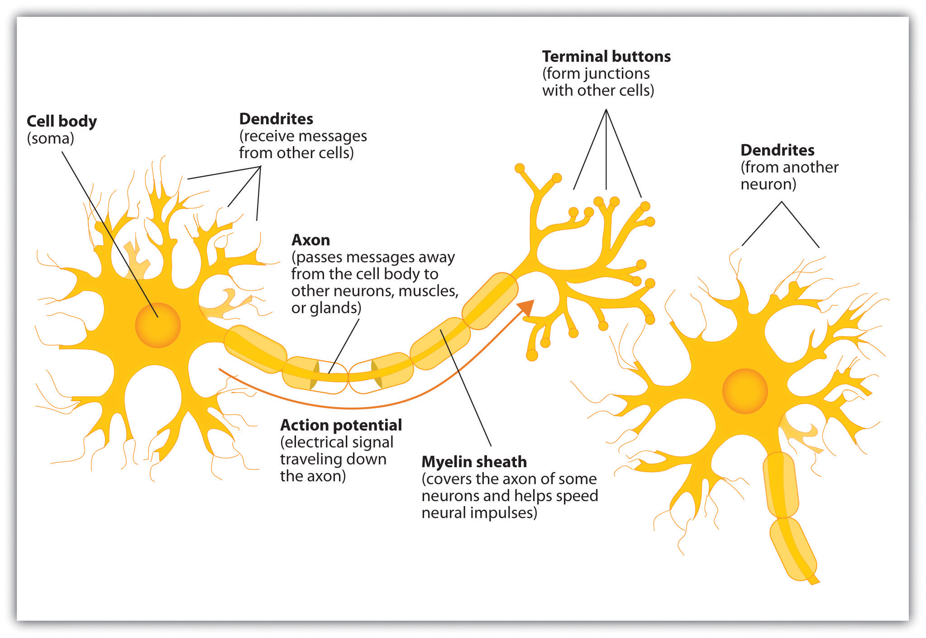
What does Neural Network Comprises of?

Slide 5
What is a Neuron?
Neuron is an electrically excitable cell that receives, processes, and transmits information through electrical and chemical signals.
Three things to notice
Cell body
Number of input wires (dendrites)
Output wire (axon)
Simpler level
Neuron gets one or more inputs through dendrites
Does processing
Sends output down axon
Neurons communicate through electric spikes
Pulse of electricity via axon to another neuron

Slide 6
What is a Dendrite?
Dendrites are projections of a neuron (nerve cell) that receive signals (information) from other neurons
The information transfer is usually received at the dendrites through chemical signals, then it travels to the cell body, continues along the neuronal axon as electric impulses, and
It is finally transferred onto the next neuron at the synapse, which is the place where the two neurons exchange information through chemical signals

Slide 8
What is a Axon?
An Axon is a long, slender projection of a neuron, that typically conducts electrical impulses known as action potentials.
The function of the axon is to transmit information to different neurons, muscles, and glands

Slide 9
Architecture
of
Artificial Neural Network

Slide 10
Artificial Neural Network
Neural networks were developed as a way to simulate networks of neurons
The idea of ANNs is based on the belief that working of human brain by making the right connections, can be imitated using silicon and wires as living neurons and dendrites.
In an artificial neural network, a neuron is a logistic unit
Feed input via input wires
Logistic unit does computation
Sends output down output wires
ANNs are capable of learning, which takes place by altering weight values

Slide 11
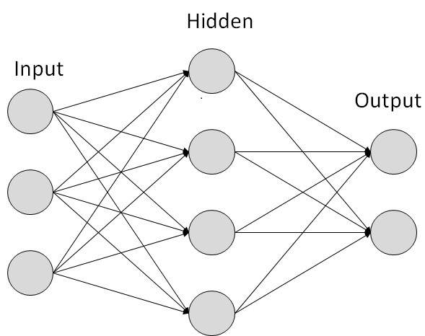
How Does ANN look like?

Slide 12
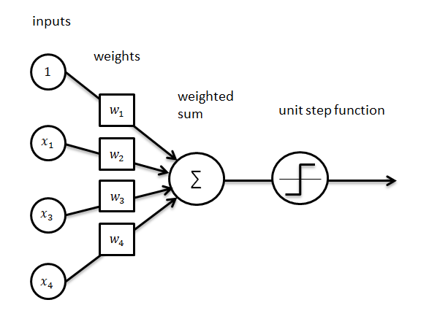
What is a Perceptron?

Slide 13
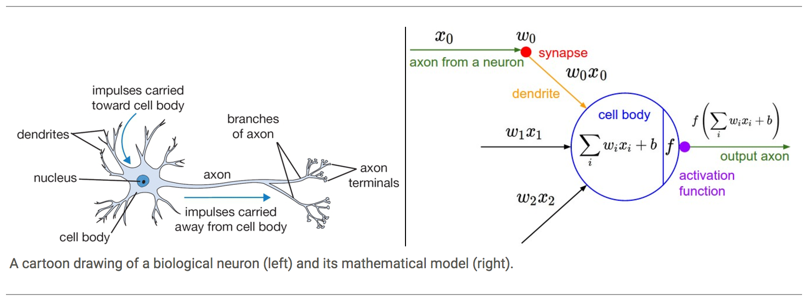
Neuron vs Perceptron

Slide 14
Approaching a Machine learning problem
Understanding the problem
Collecting proper data set
Model Representation
Hypothesis
Cost Function
Gradient descent

Slide 15
Understanding the problem & Collecting data set
We are running a company and you want to develop learning algorithms to address each of two problems
You have a large inventory of identical items. You want to predict how many of these items will sell over the next 3 months.
You’d like software to examine individual customer accounts, and for each account decide if it has been hacked/compromised.
Care should be taken for understanding the problem clearly and opting to go with either ML Algorithm or for other solutions.

Slide 16
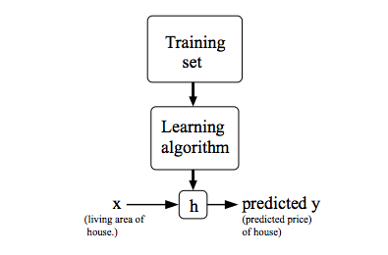
Model Representation

Slide 17
Hypothesis
Our goal is, given a training set, to learn a function h : X → Y so that h(x) is a “good” predictor for the corresponding value of y.
The Function h is called Hypothesis

Slide 18
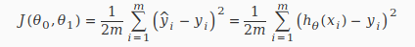
Cost function
Accuracy of hypothesis function can be measured using Cost function. It takes an average difference of all the results of the hypothesis with inputs from x’s and actual output y’s
To break it apart, it is 1/2 x¯ where x¯ is the mean of the squares of hθ(xi)−yi , or the difference between the predicted value and the actual value.
This function is otherwise called the "Squared error function", or "Mean squared error".

Slide 19
Cost function contd.,
The mean is halved 1/2 as a convenience for the computation of the gradient descent, as the derivative term of the square function will cancel out the 1/2 term.
Choose 0o and 0i, so that h(x) is close to y for our training examples.

Slide 20
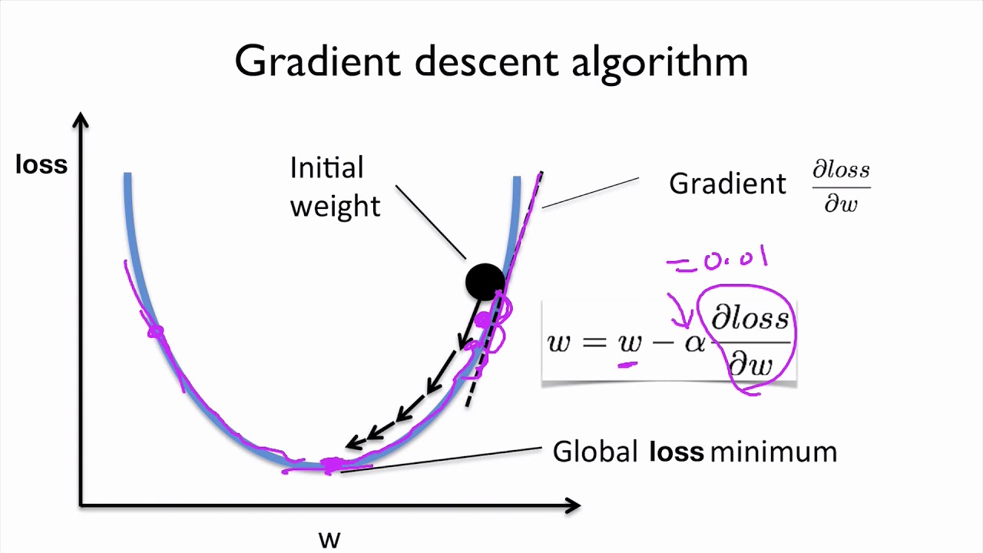
Gradient descent

Slide 21
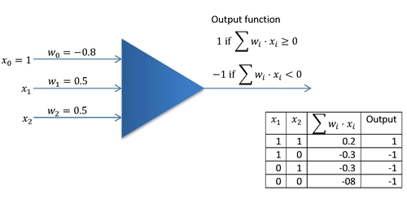
Neural Network example: AND function

Slide 22
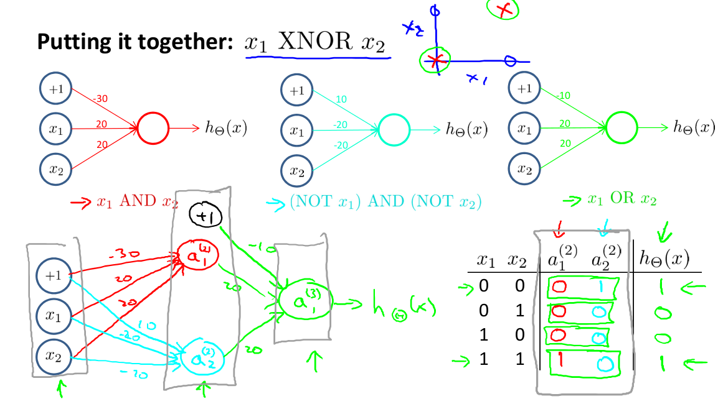
Neural Network Example: XNOR

Slide 23
Matrix vector Multiplication

Slide 24
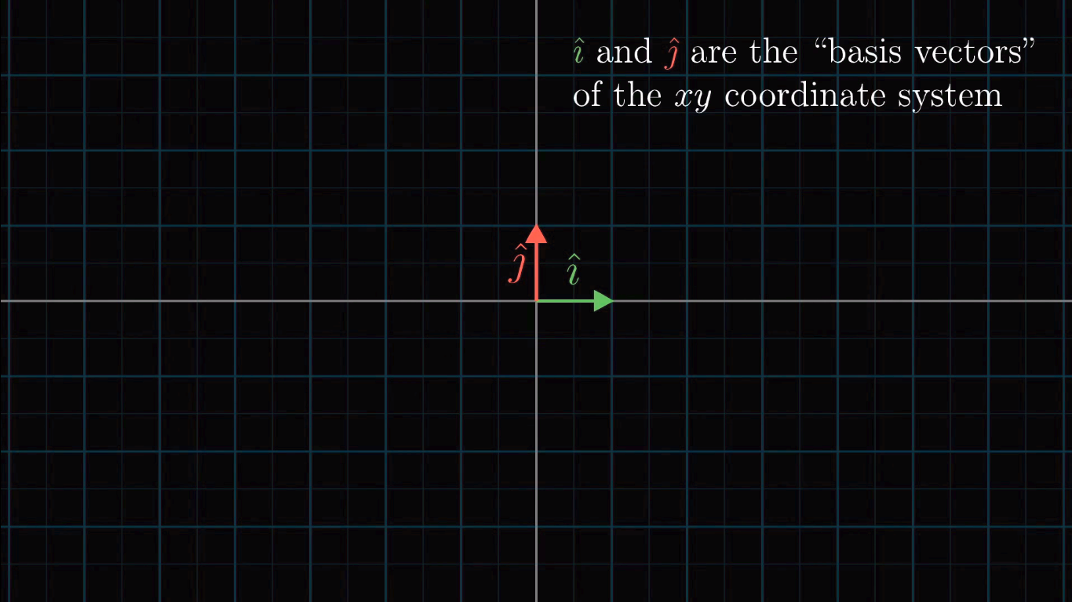

Slide 25
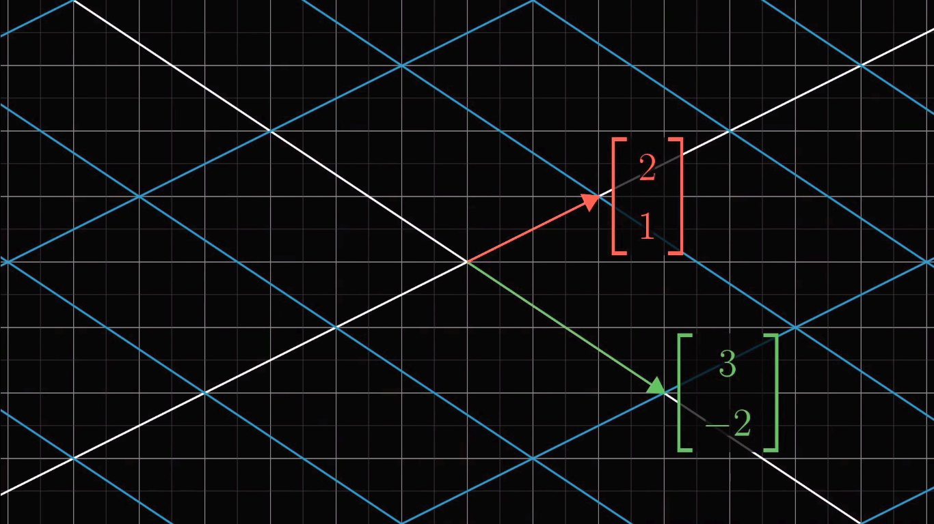

Slide 26
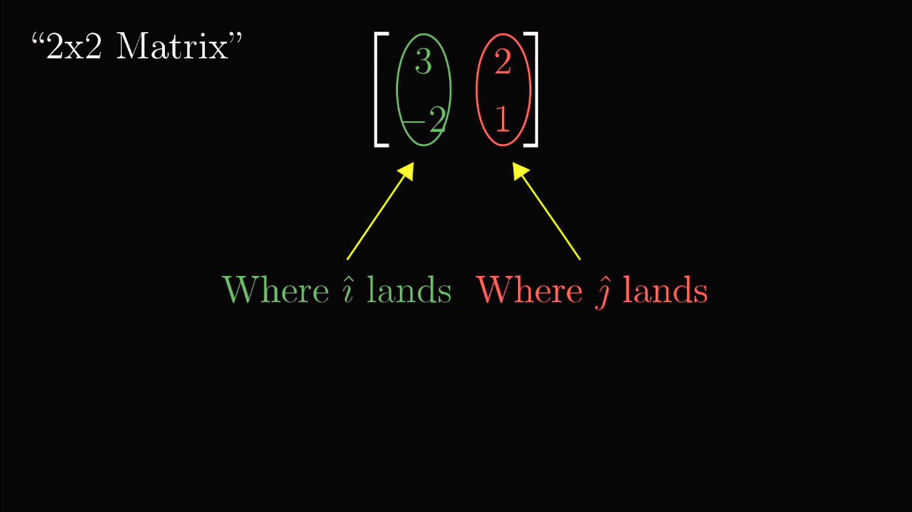

Slide 27
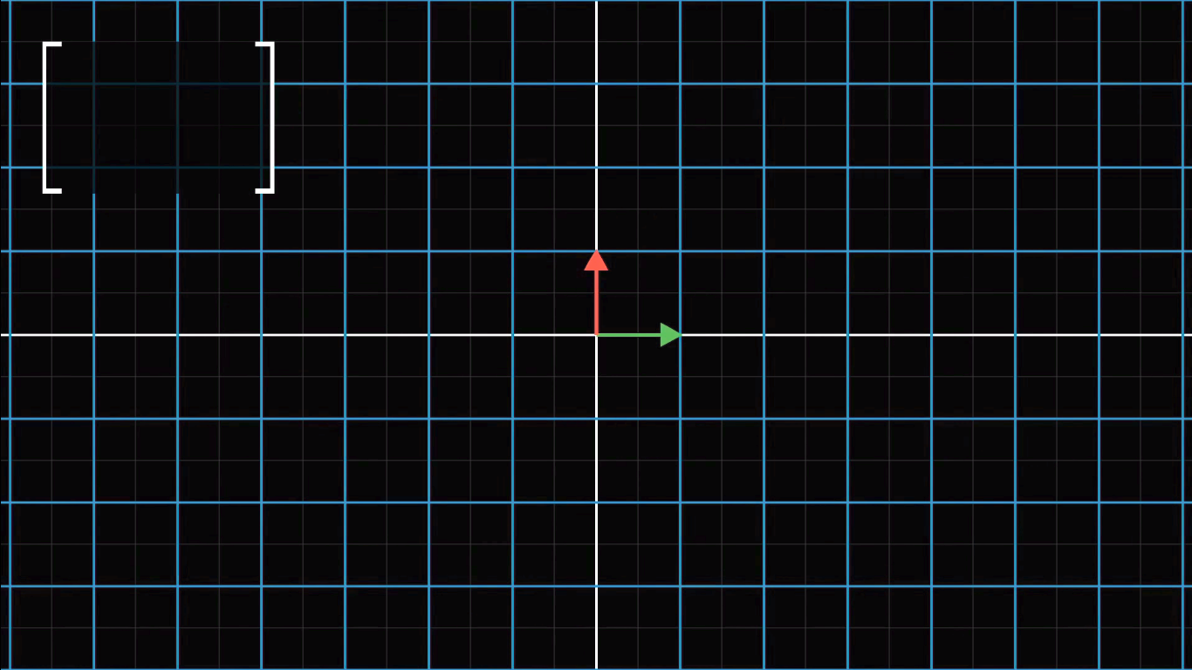

Slide 28
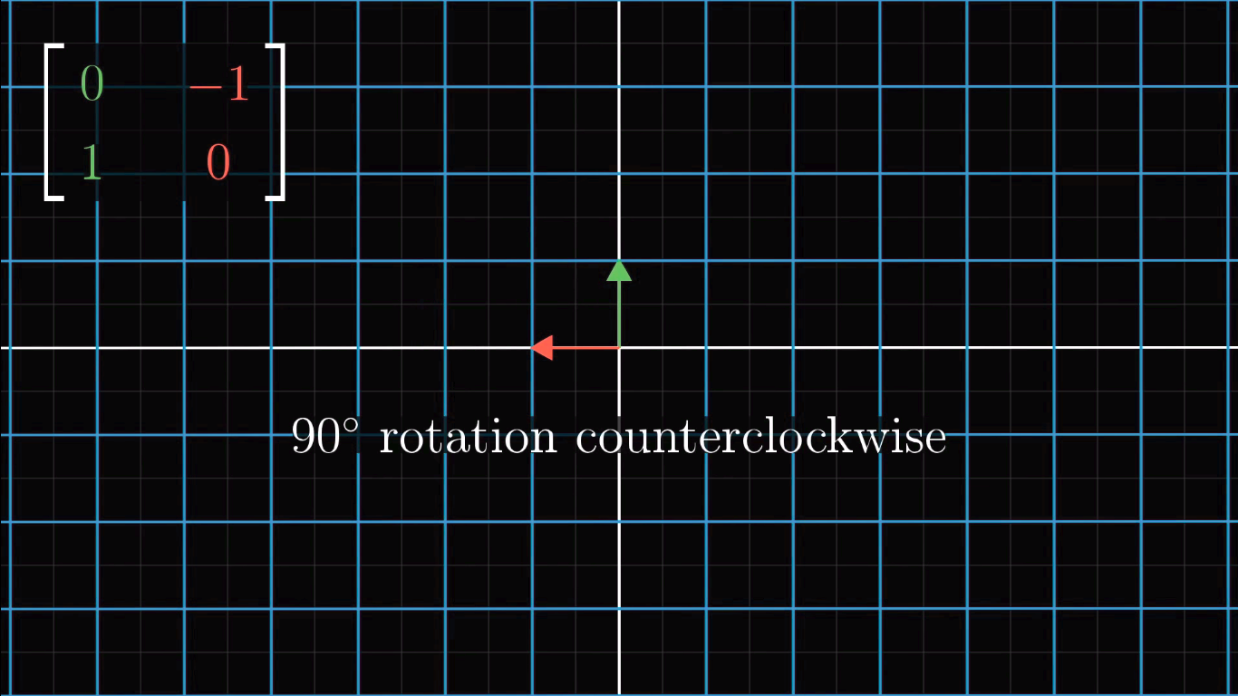

Slide 29
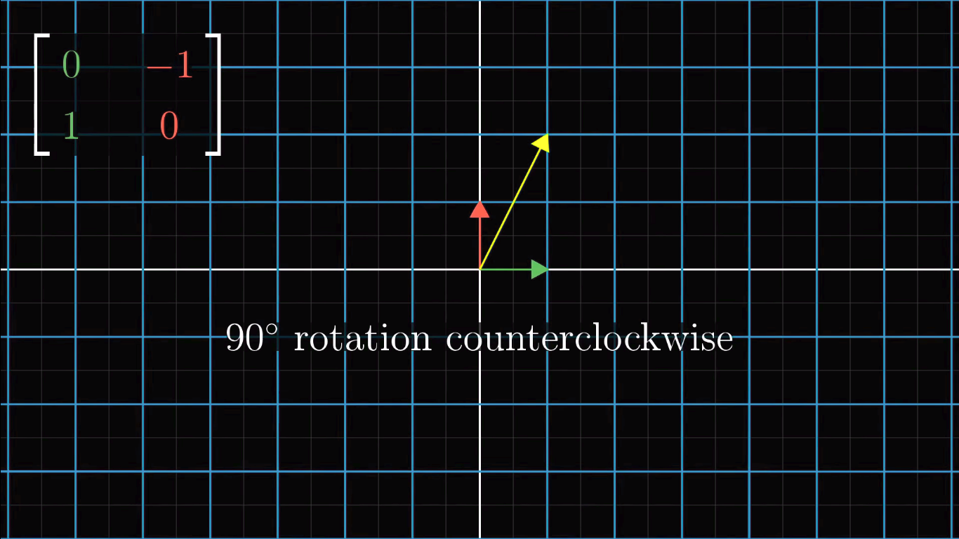

Slide 30
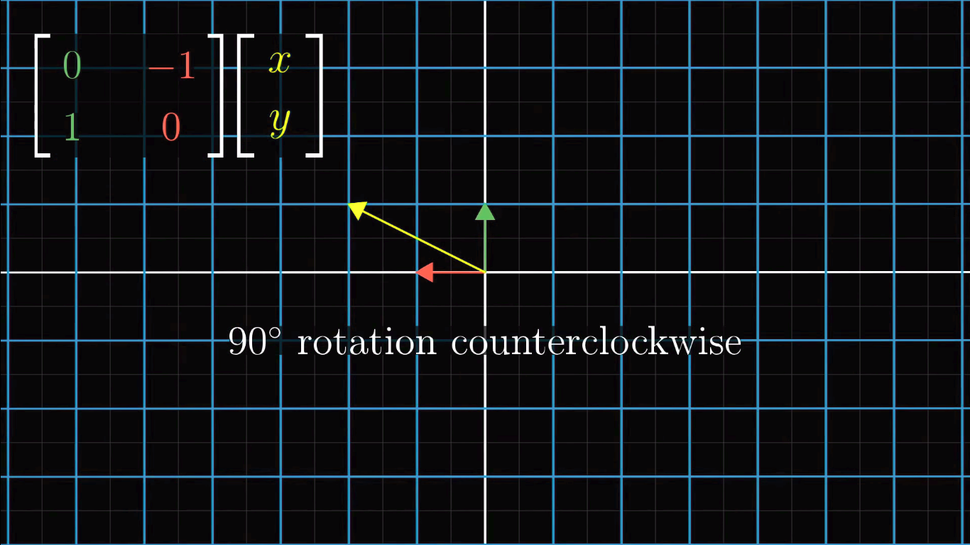

Slide 31
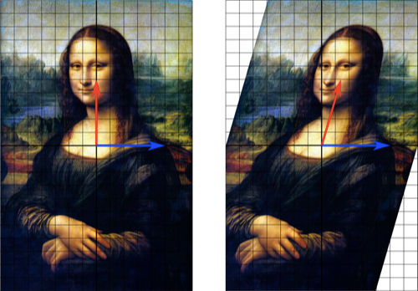
What happens when we apply shear?

Slide 32
Hello World

Slide 33

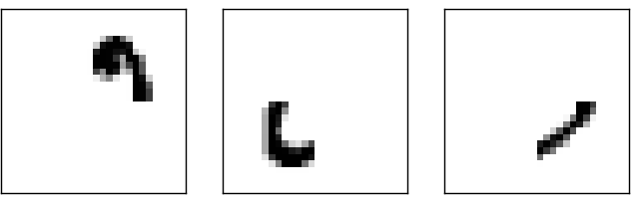

Slide 34
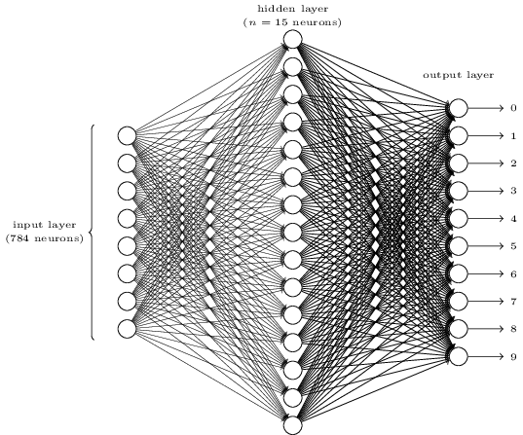
A simple network to classify handwritten digits

Slide 35
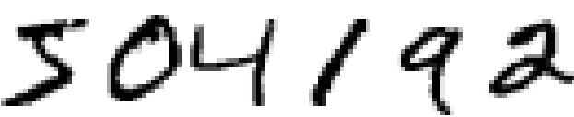
How do we recognize this using ANN

Slide 36
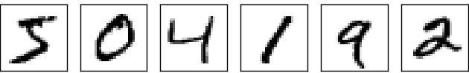
Split

Slide 37
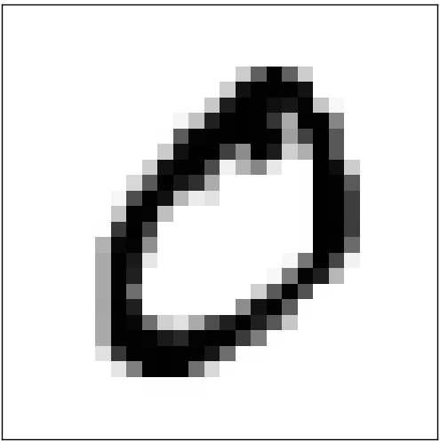

Slide 38


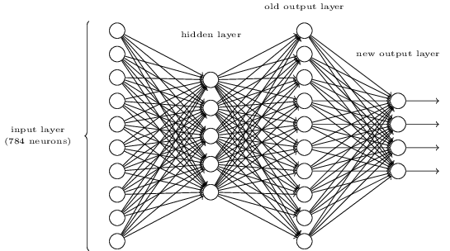


Slide 39
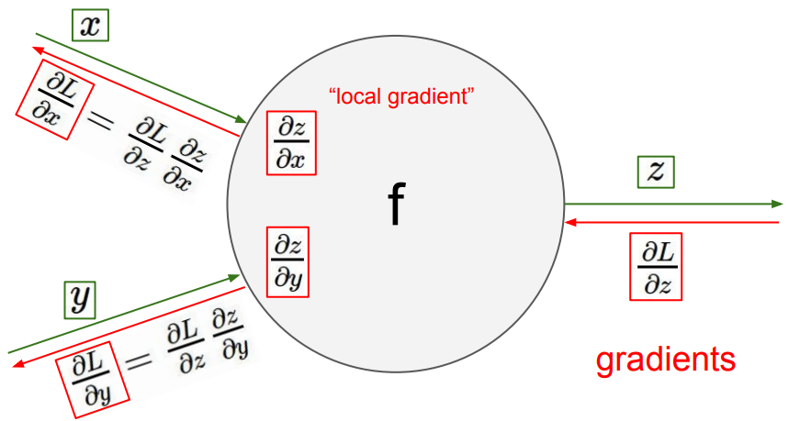

Slide 40
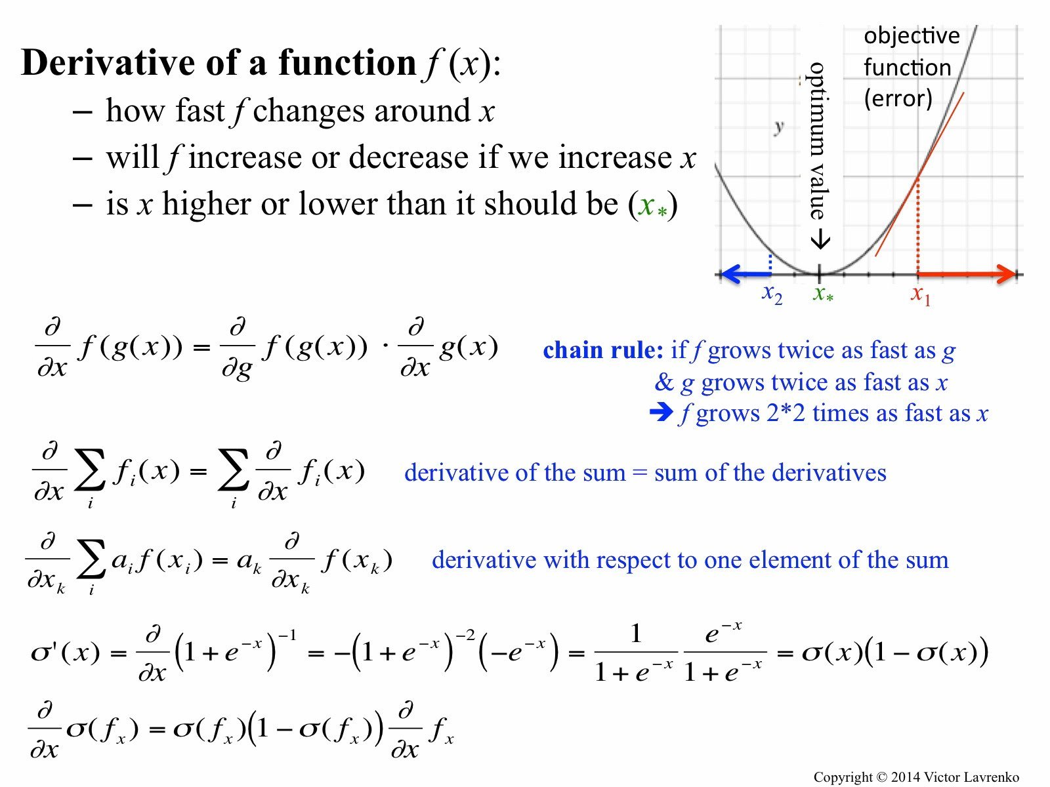

Slide 41
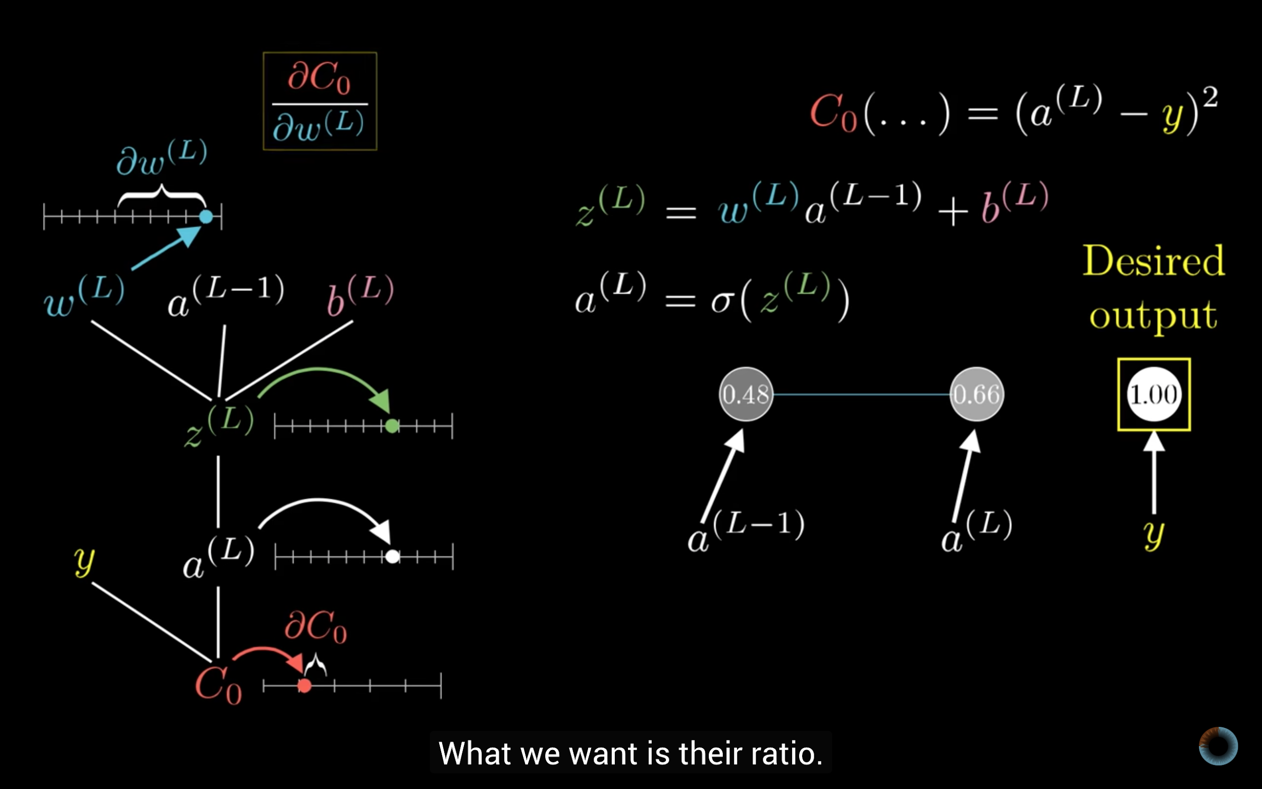

Slide 42
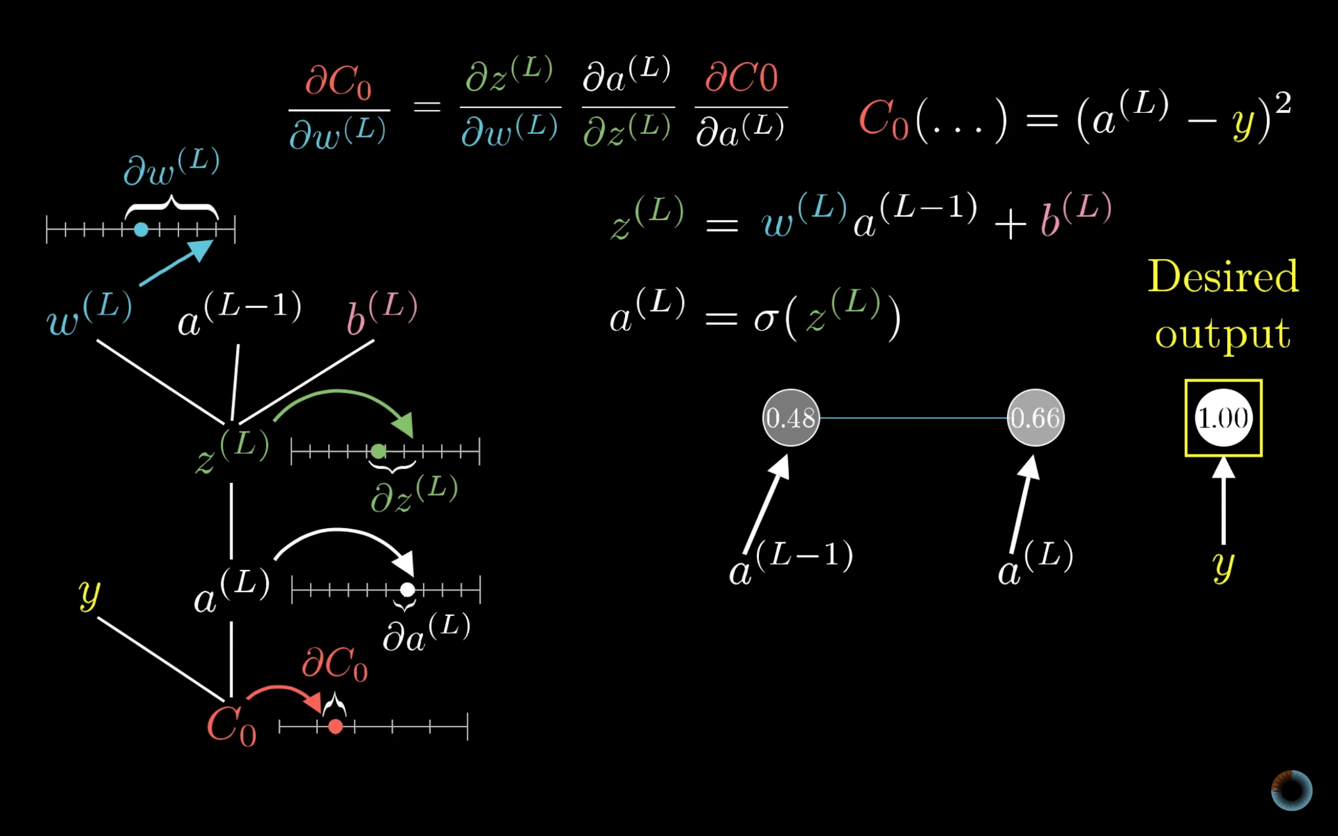

Slide 43
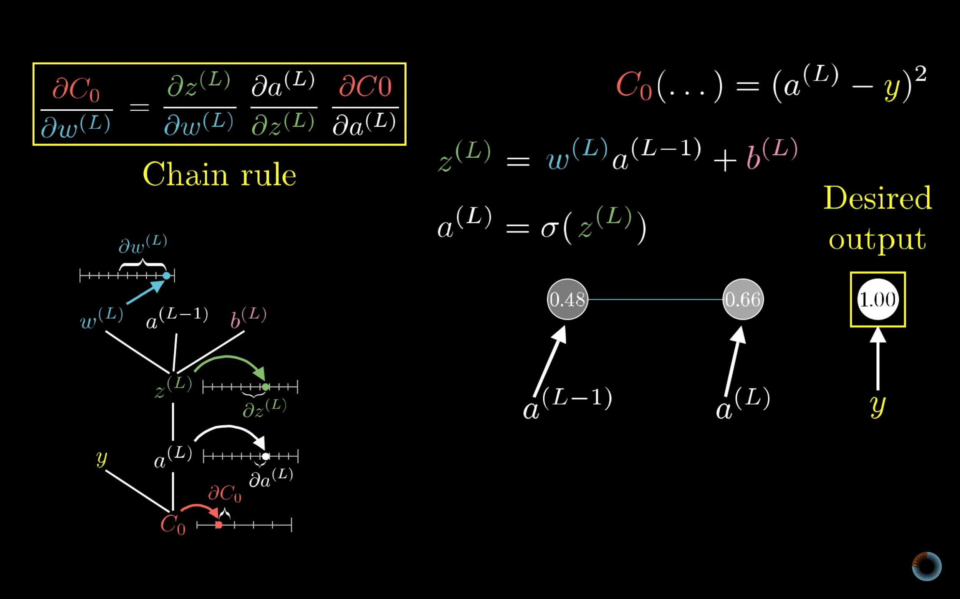

Slide 44
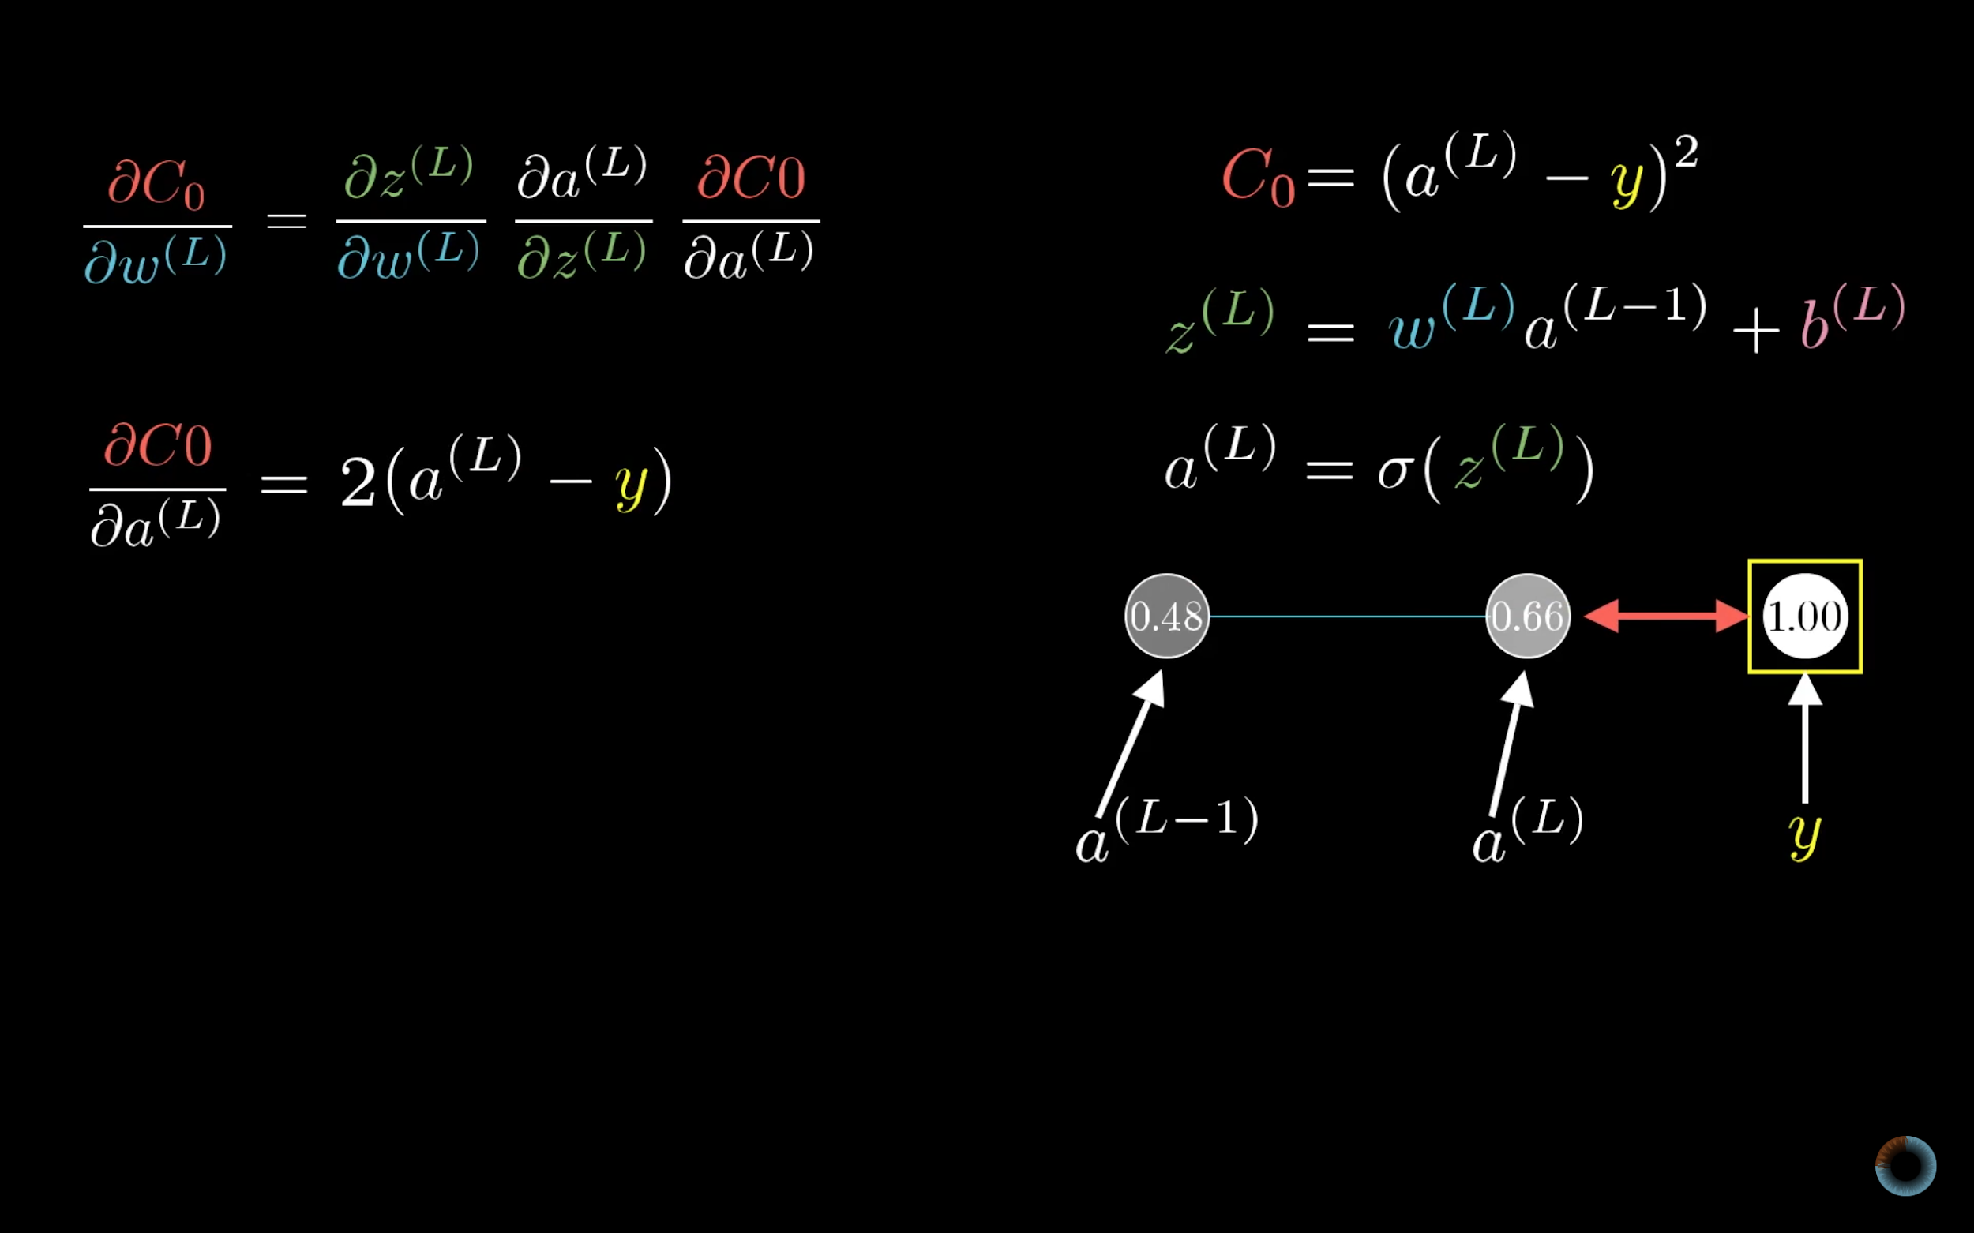

Slide 45
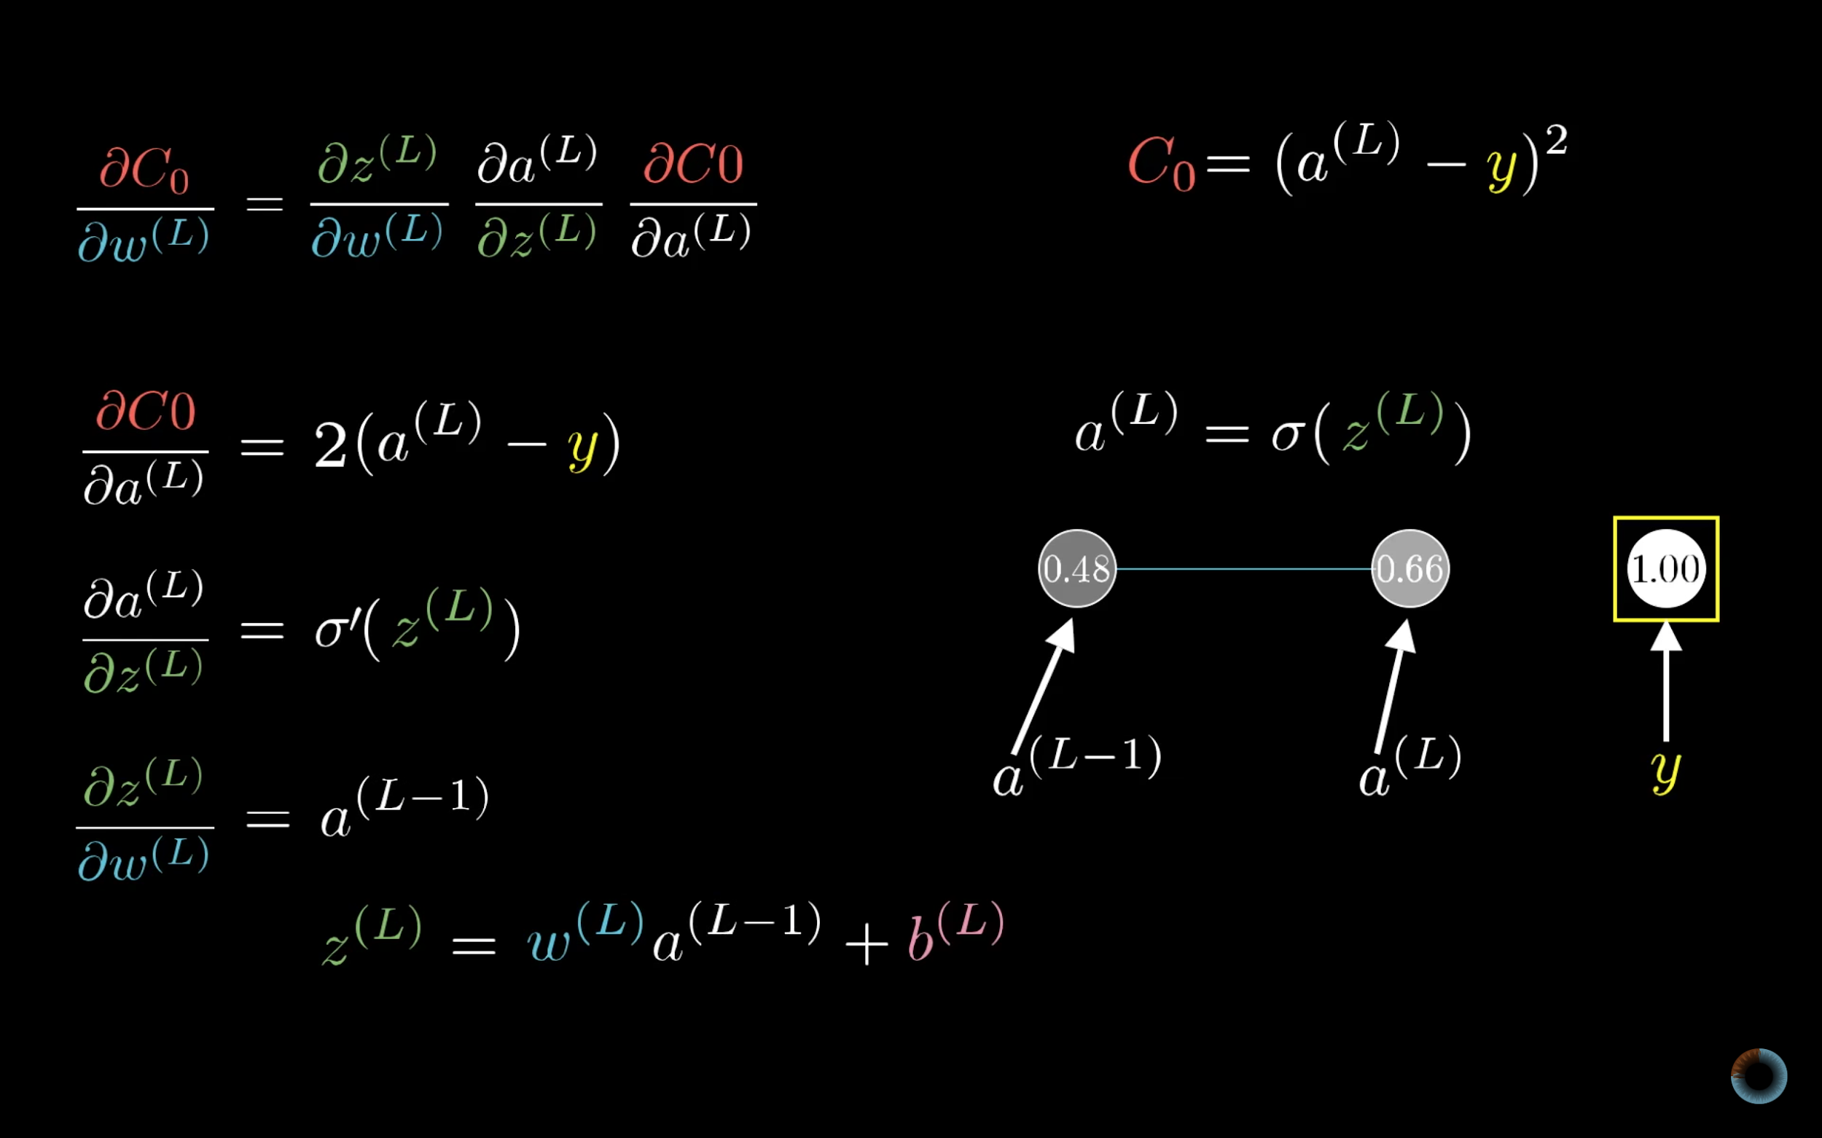

Slide 46
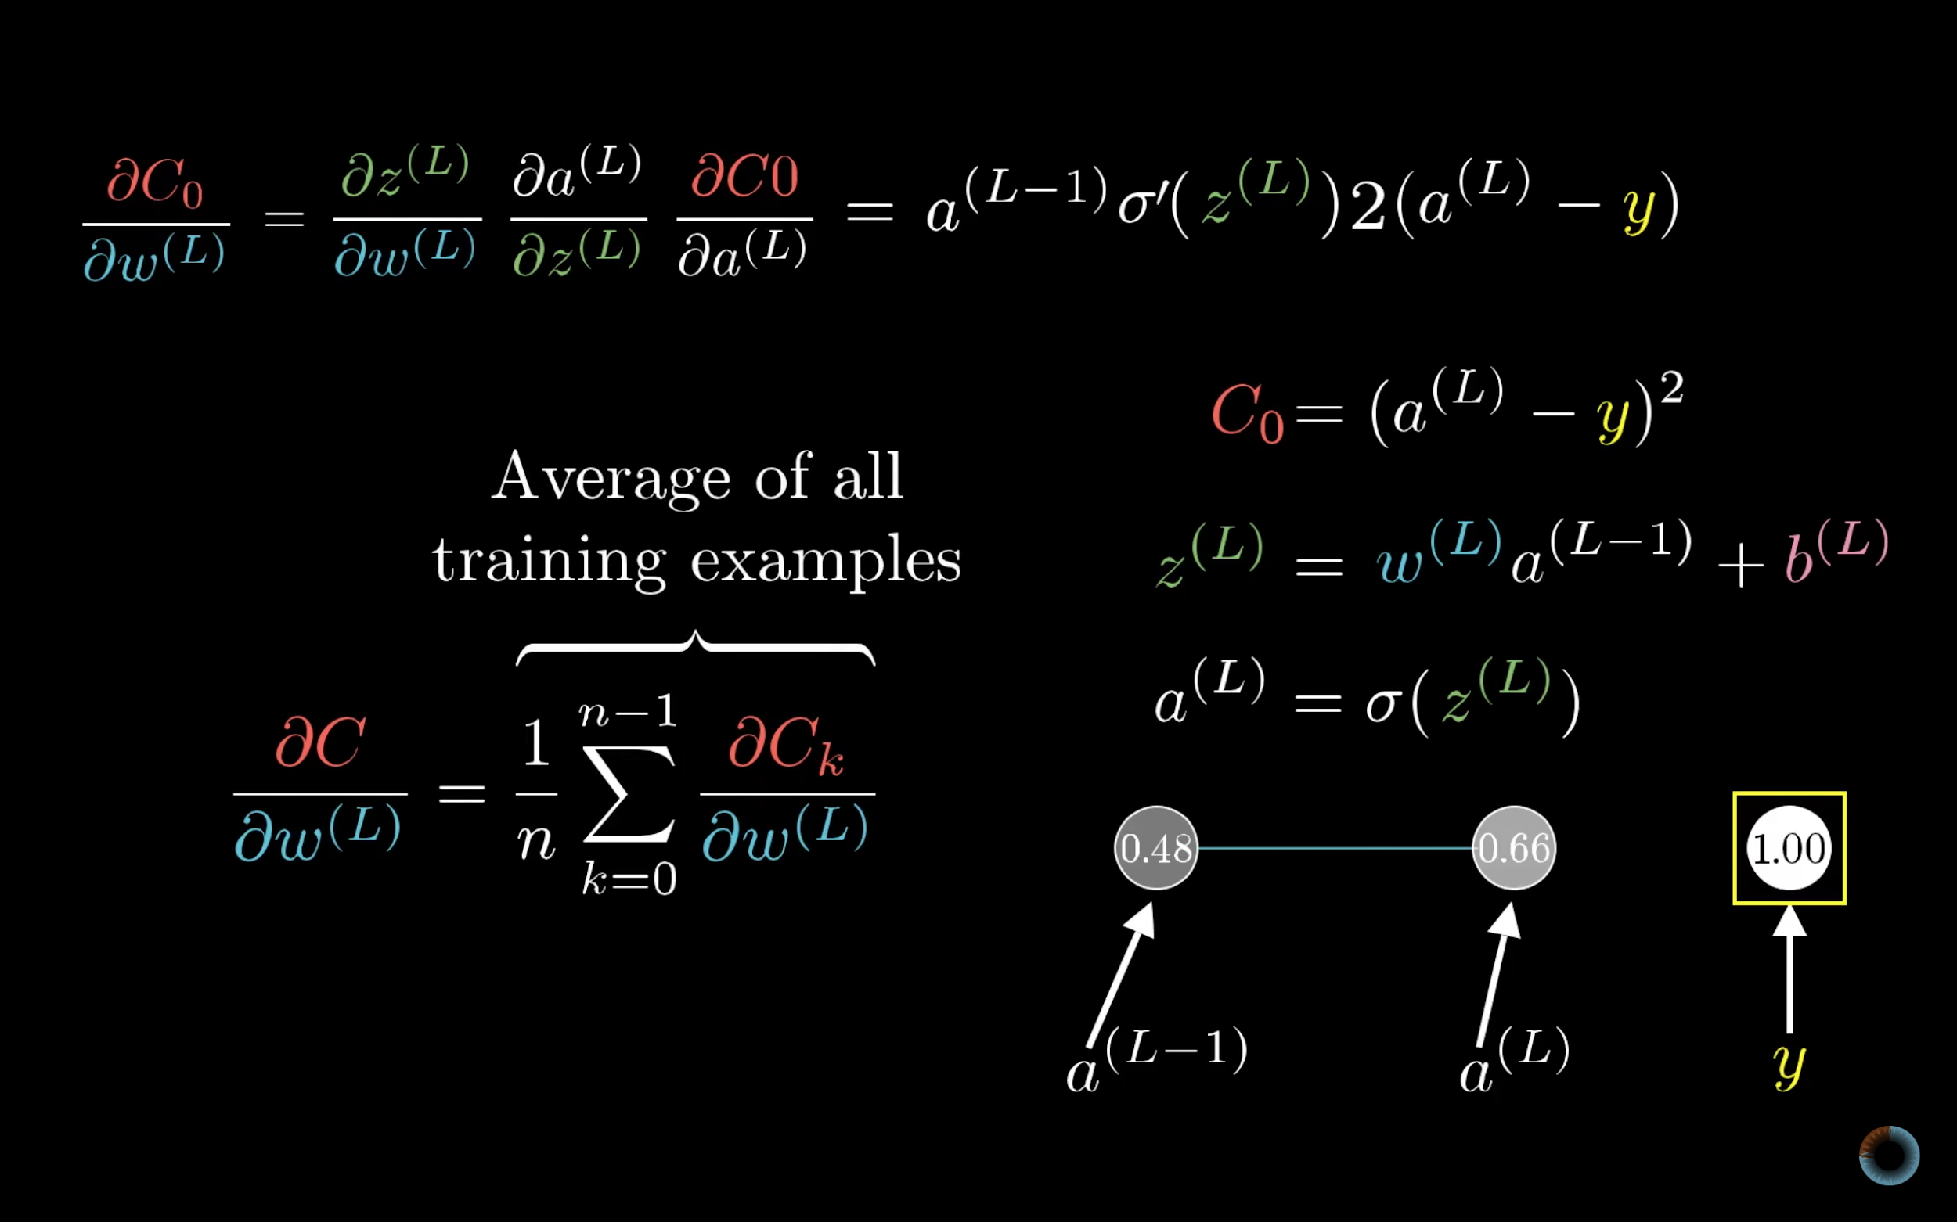

Slide 47
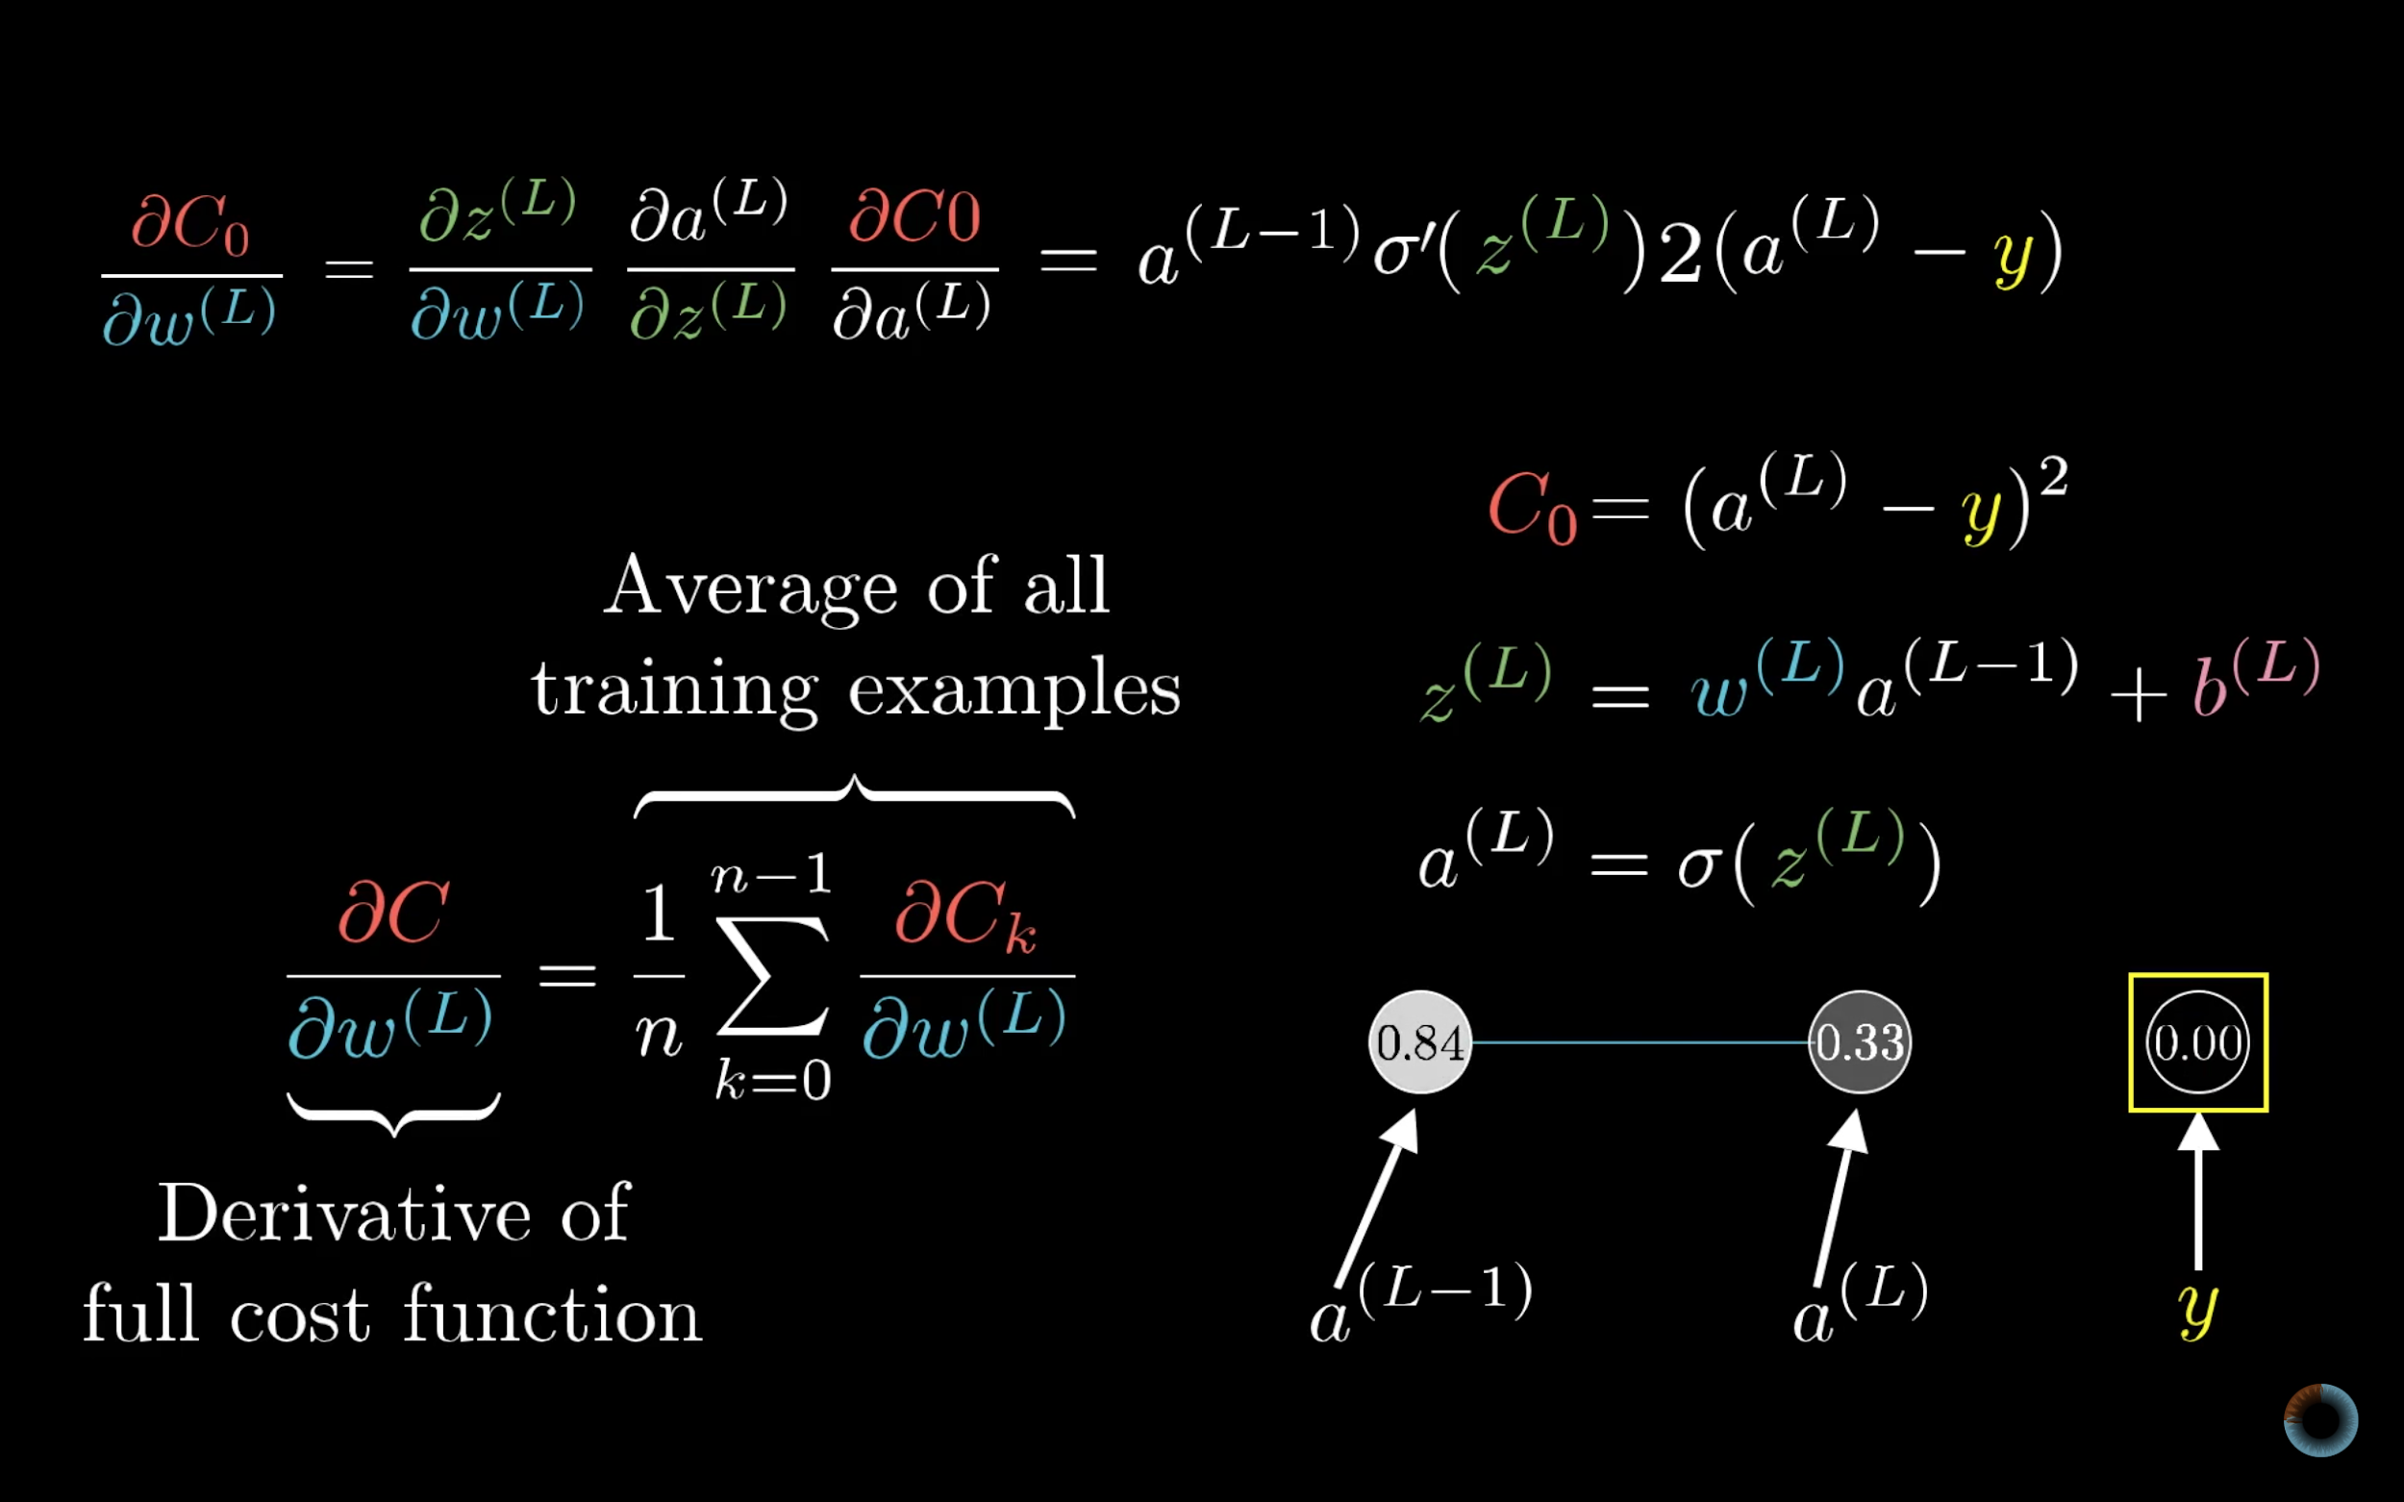

Slide 48
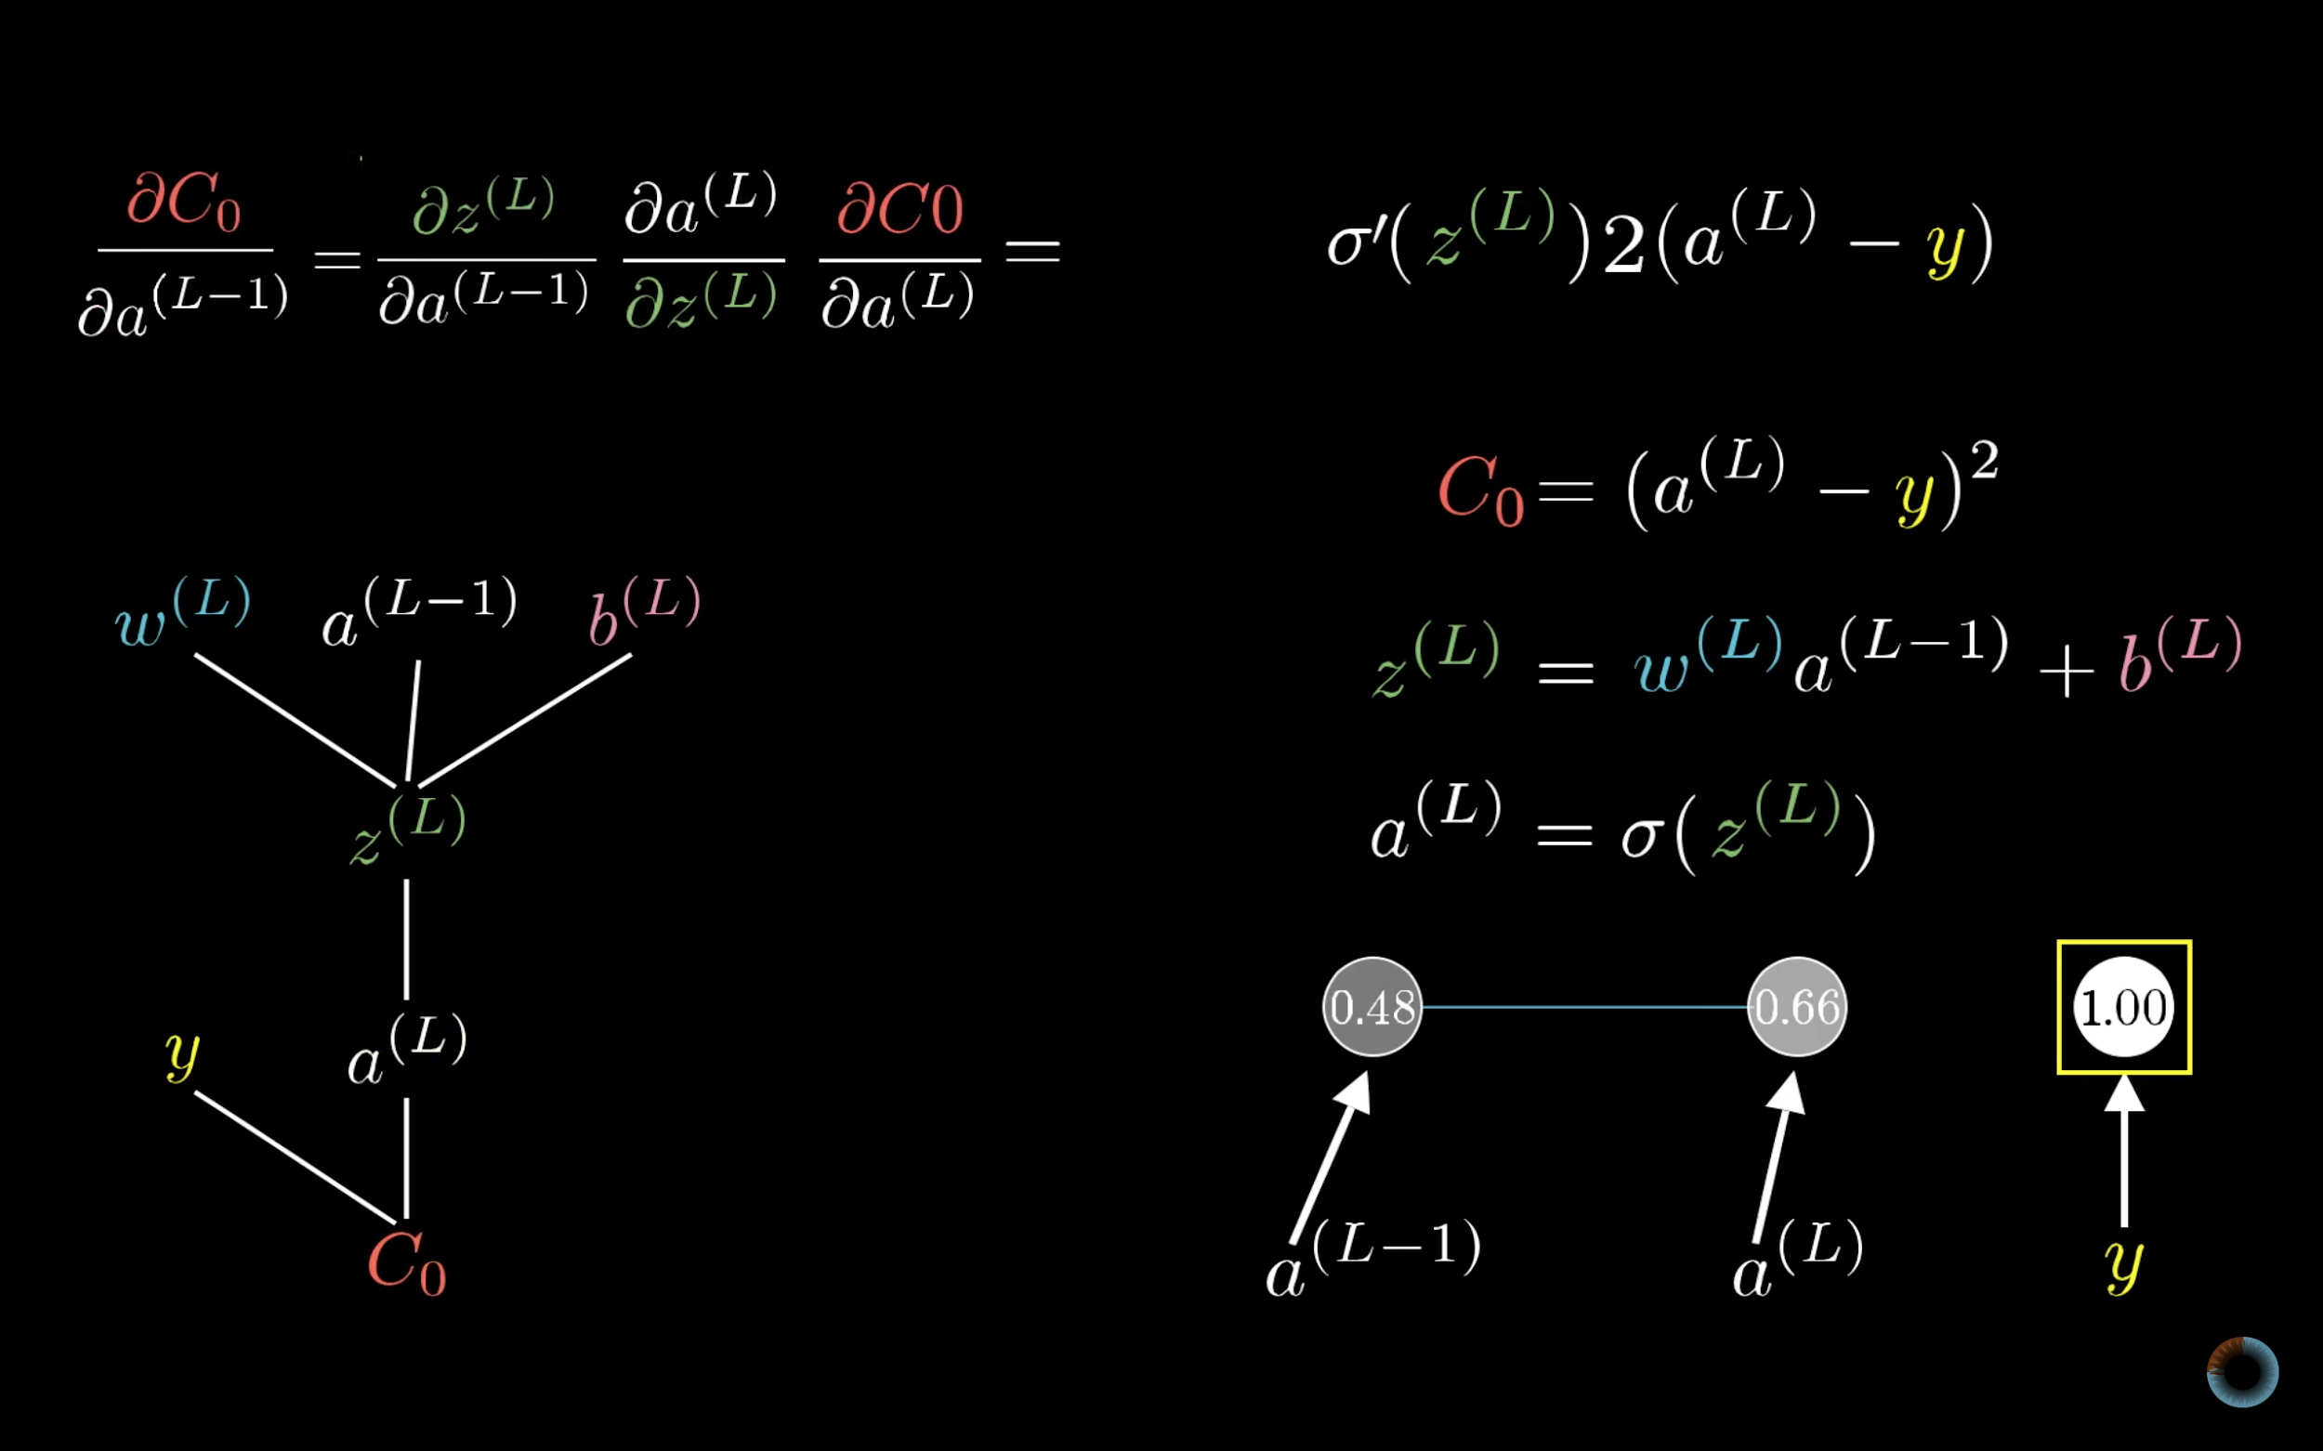

Slide 49
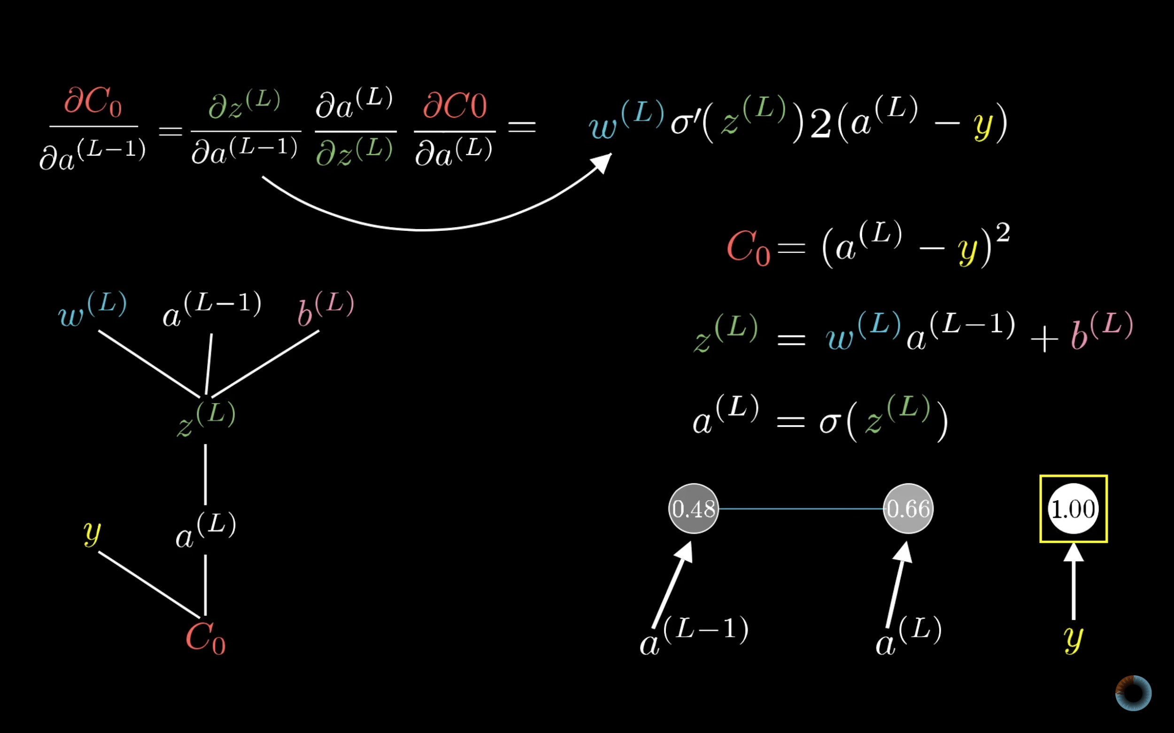

Slide 51
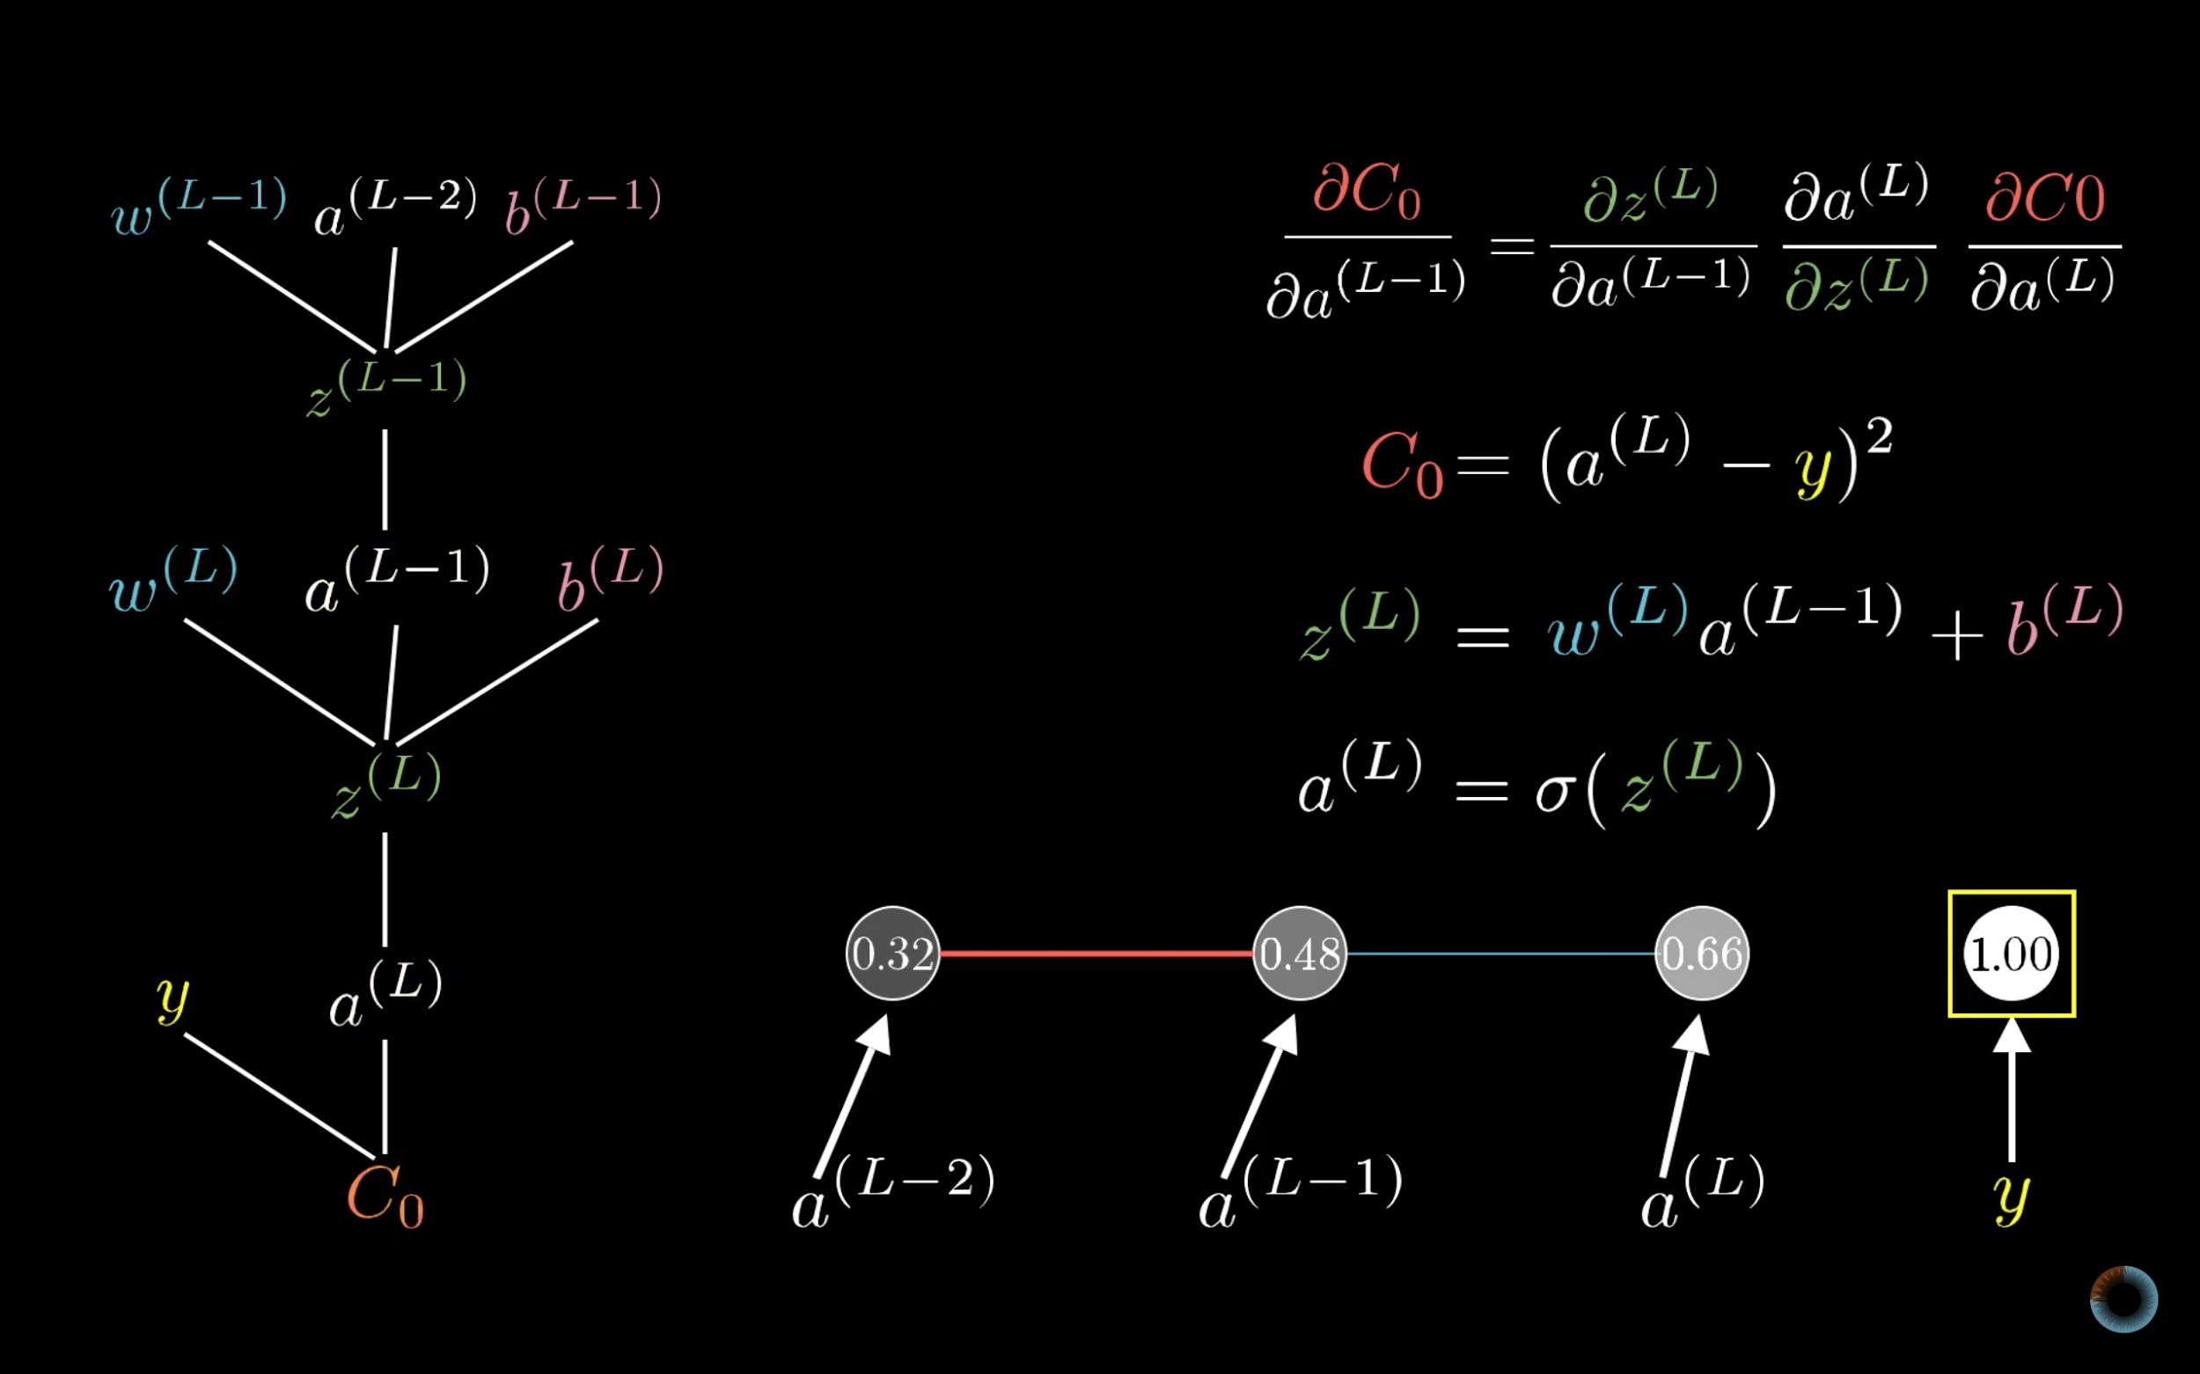

Slide 52
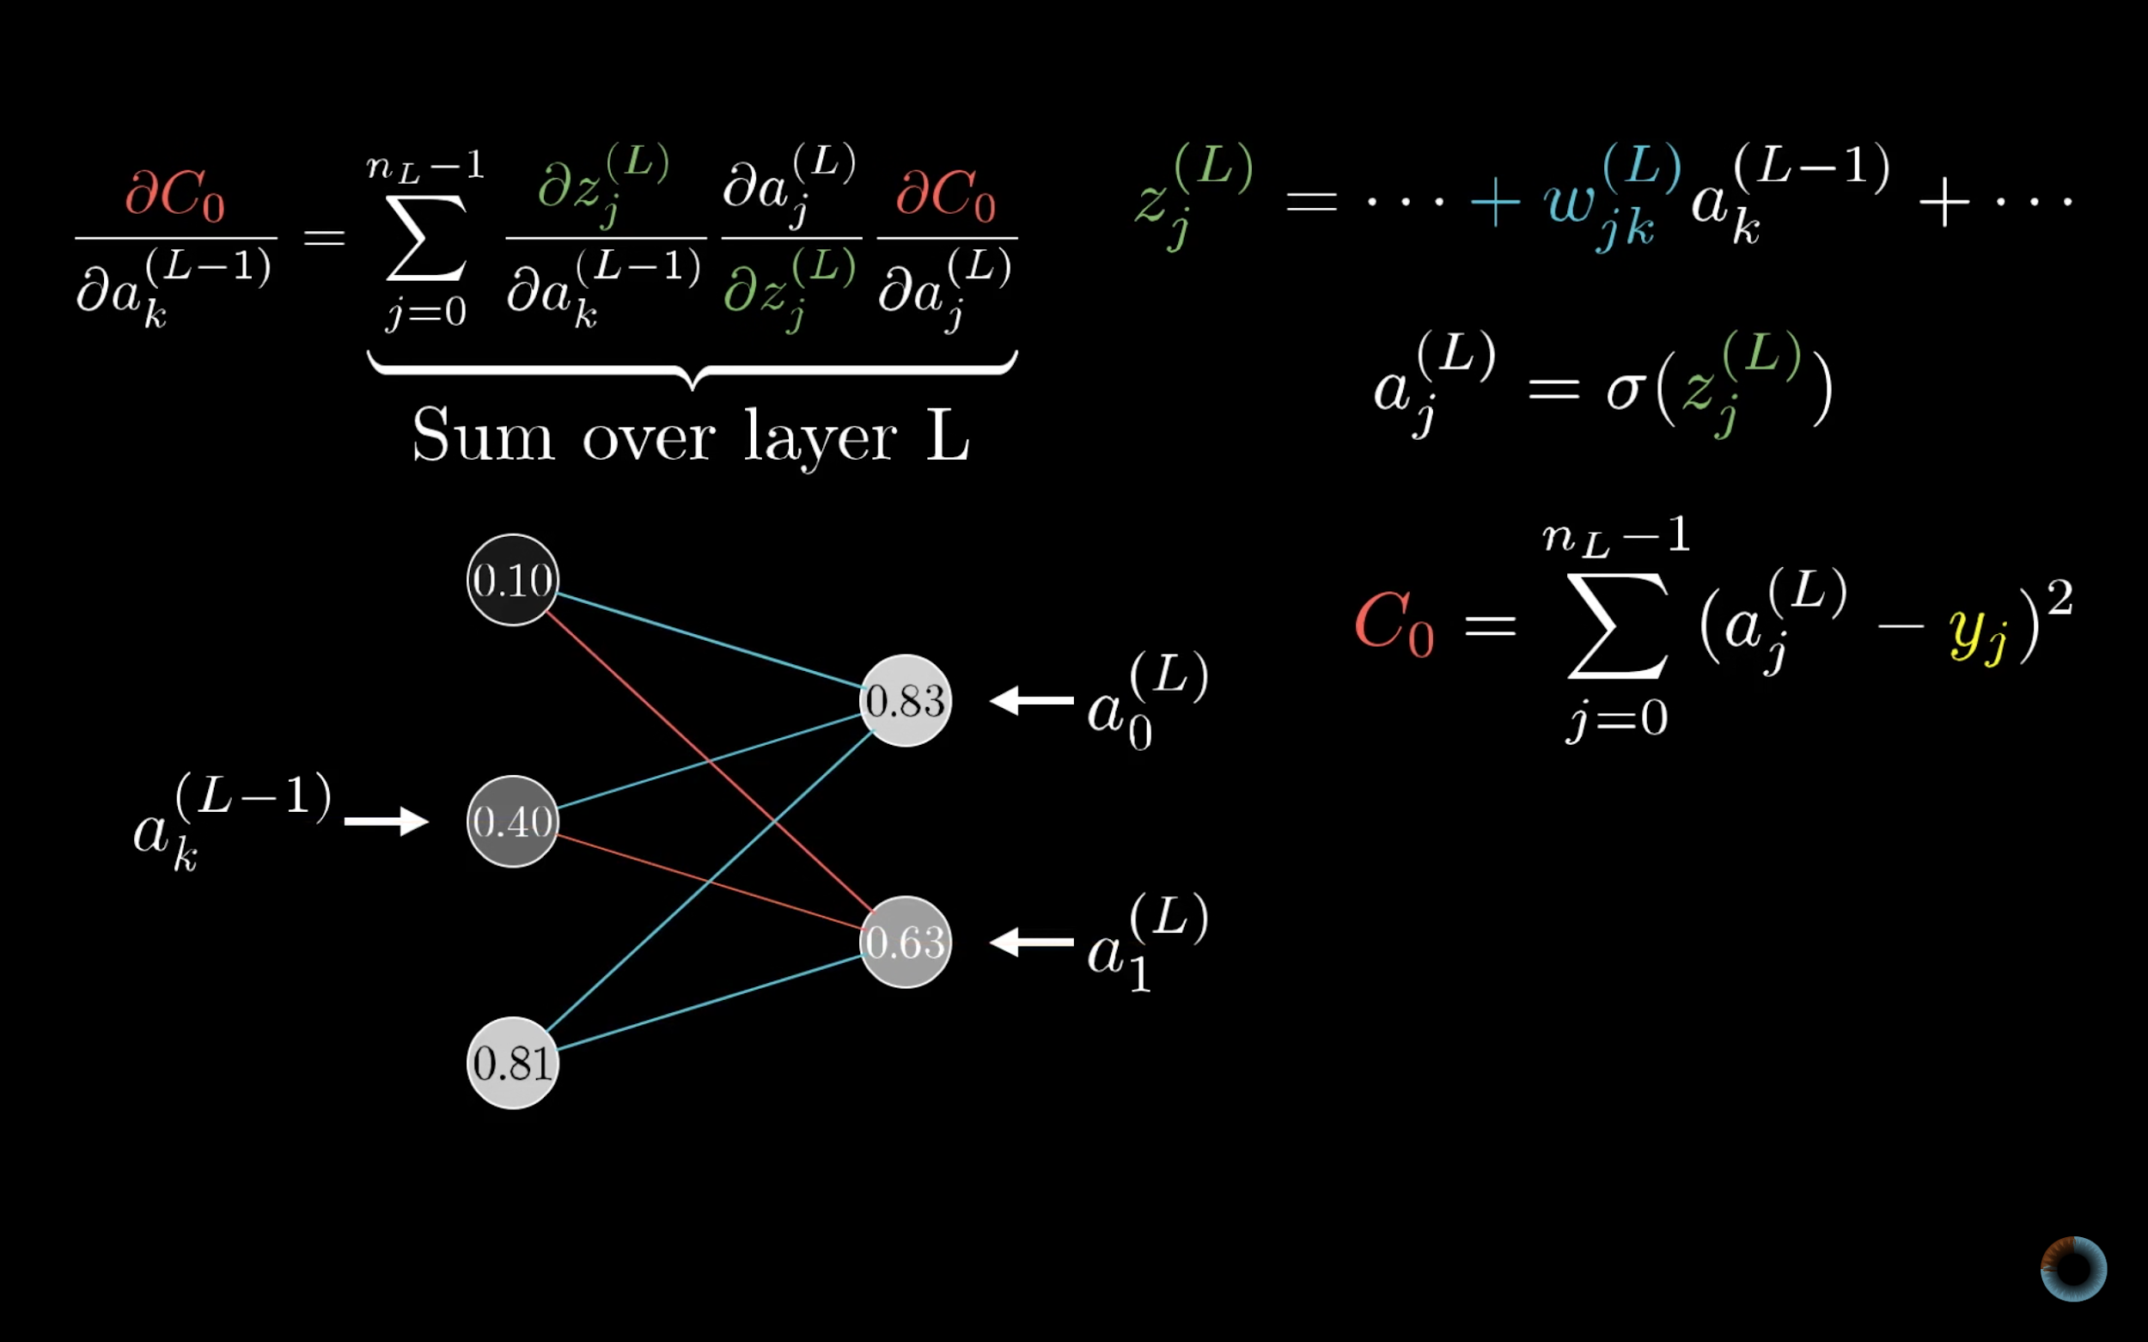

Slide 53
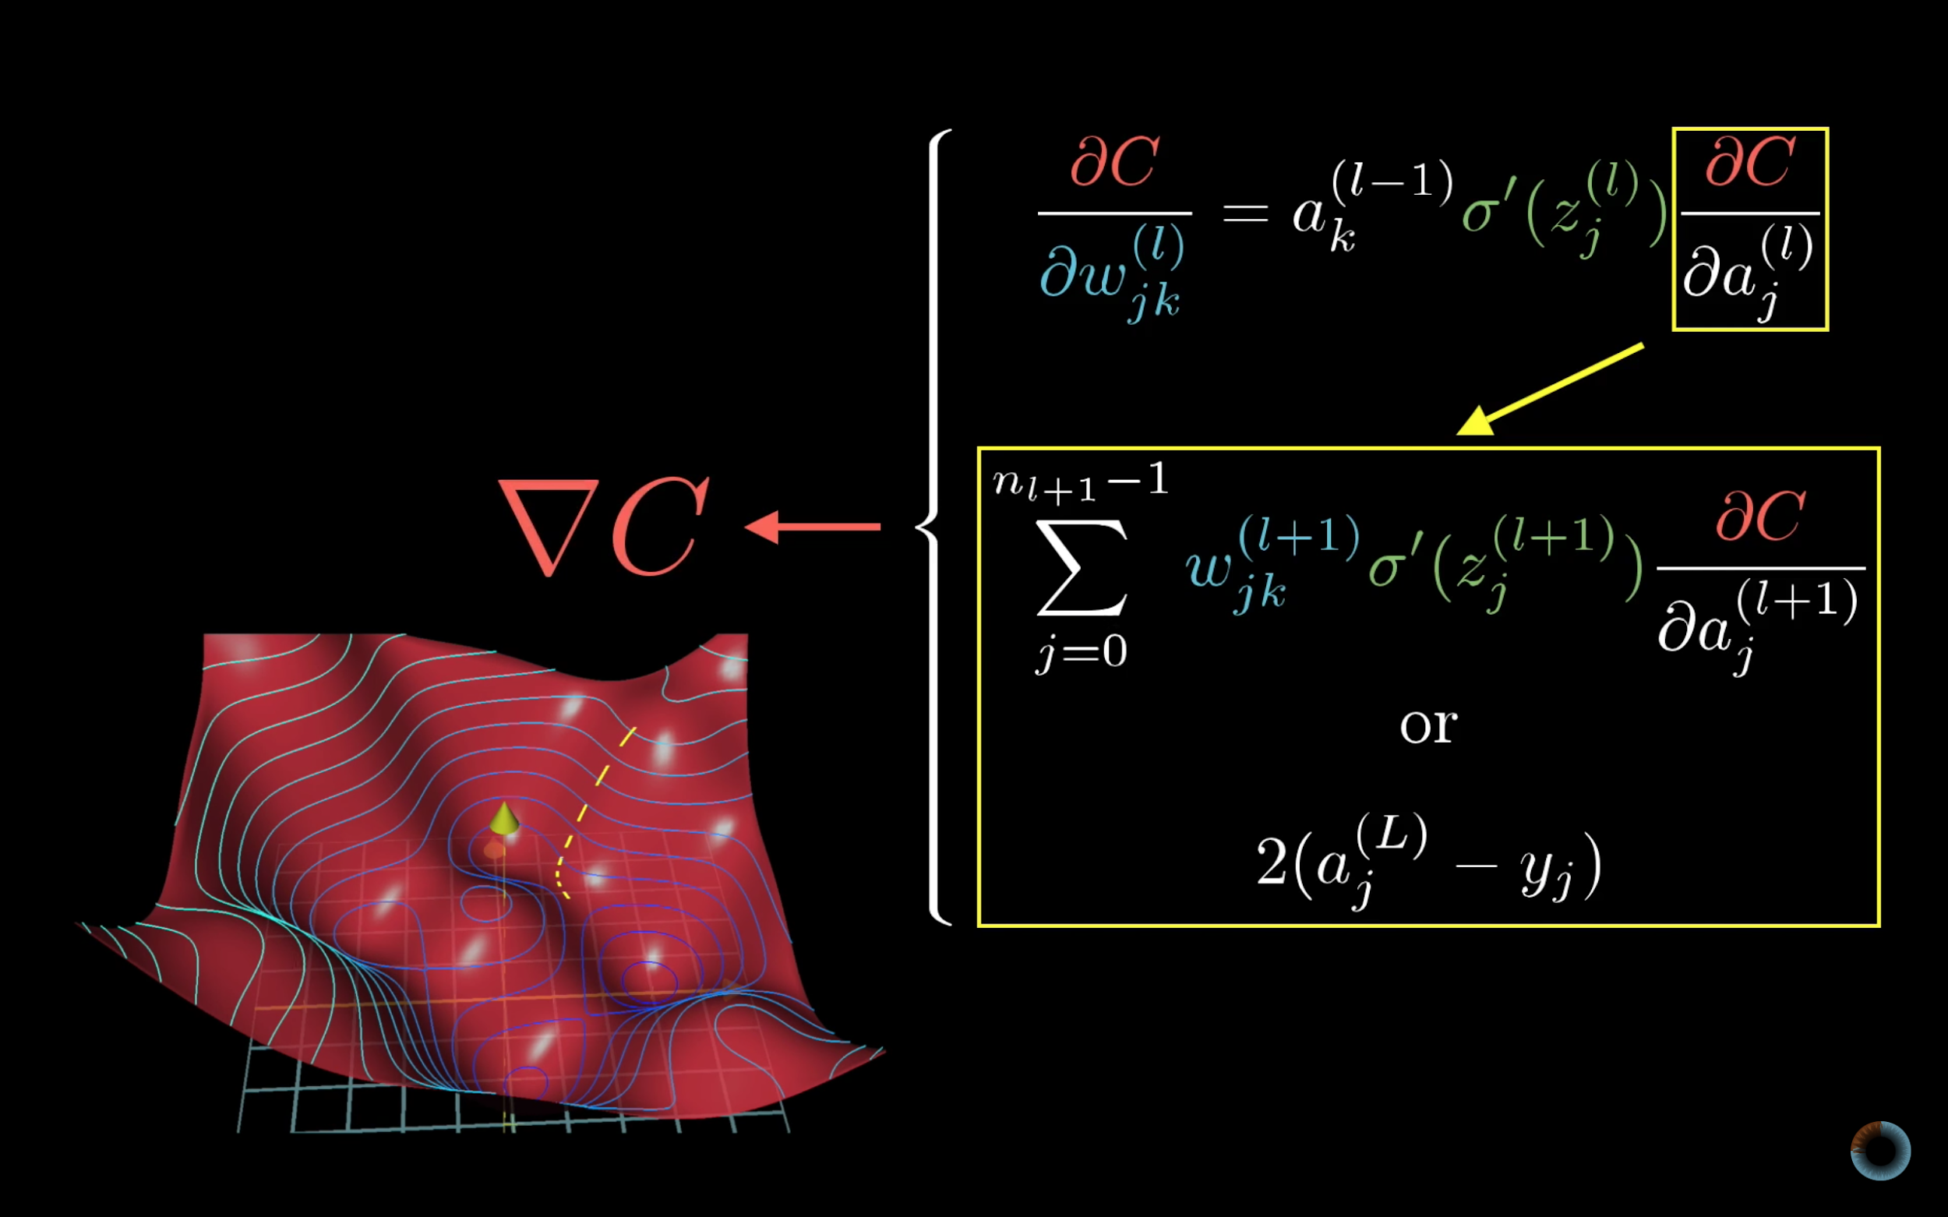

Slide 54
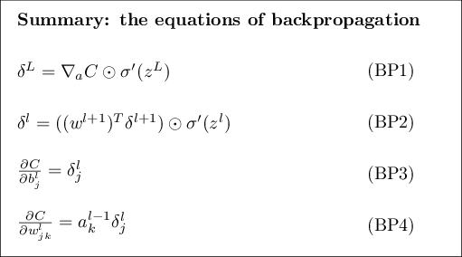

Slide 55
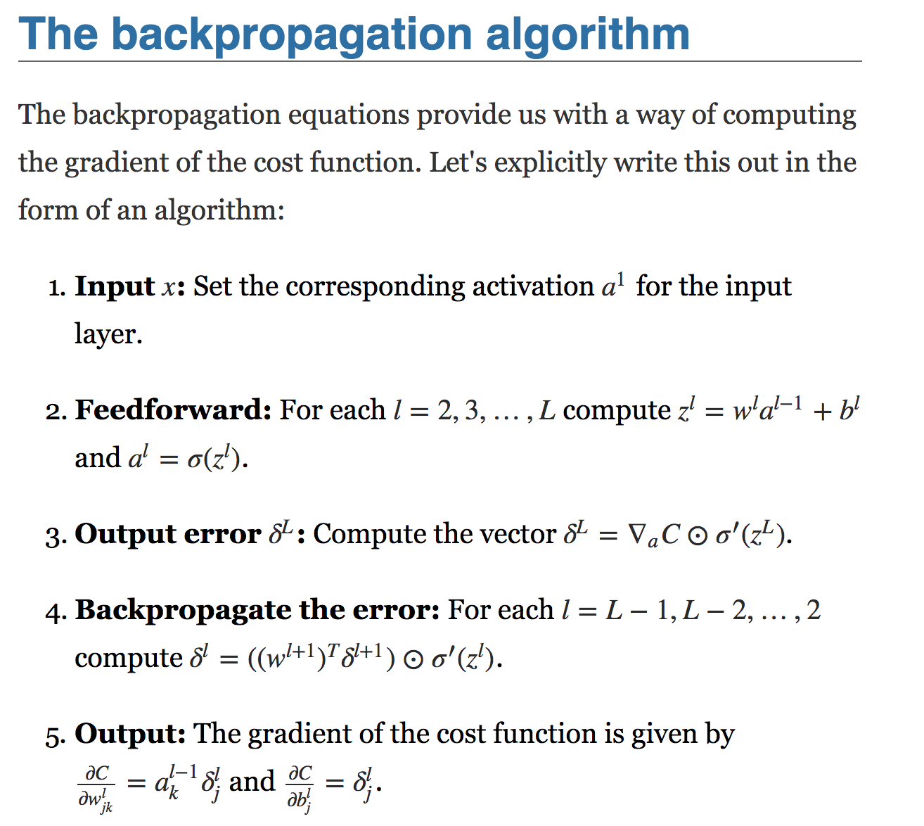

Slide 56
References
http://neuralnetworksanddeeplearning.com/chap2.html
https://www.youtube.com/playlist?list=PLZHQObOWTQDNU6R1_67000Dx_ZCJB-3pi
Machine Learning Course by AndrewNG

